Slide 1
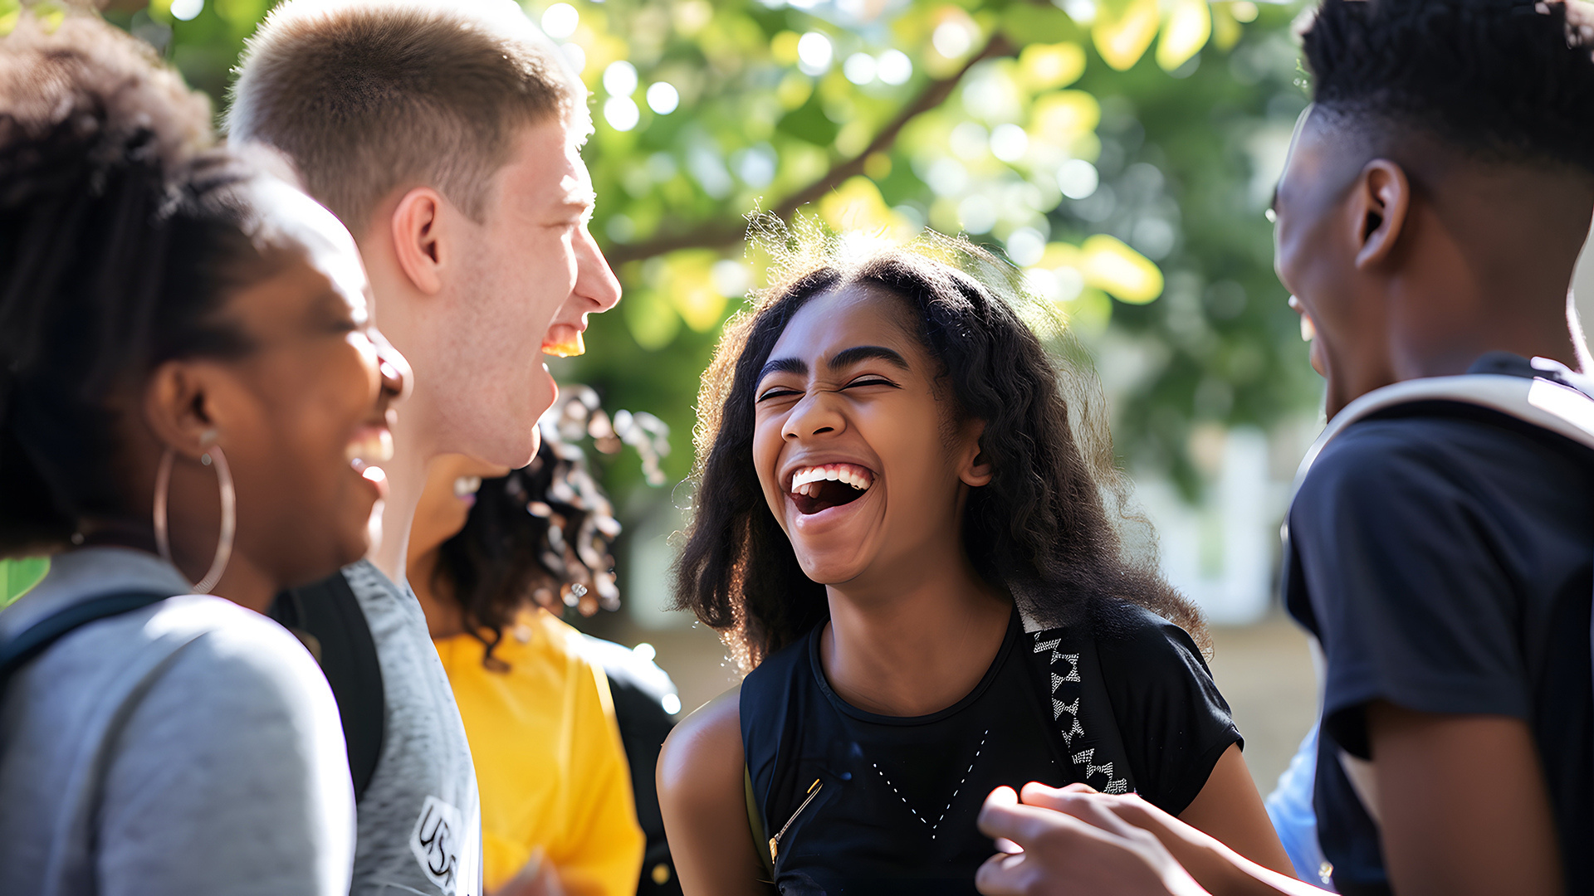




Striving for silver
@GaisceAward

Slide 2


Slide 3
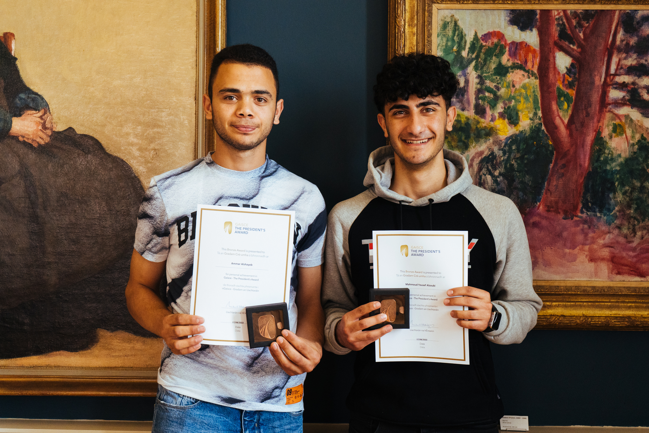

WHAT IS THE GAISCE AWARD?
A self-development programme for young people between the ages of 14 - 25 in Ireland.
Non–Formal
Non–Competitive
Self–Directed
Image: Wavelength participants at an award ceremony

Slide 4
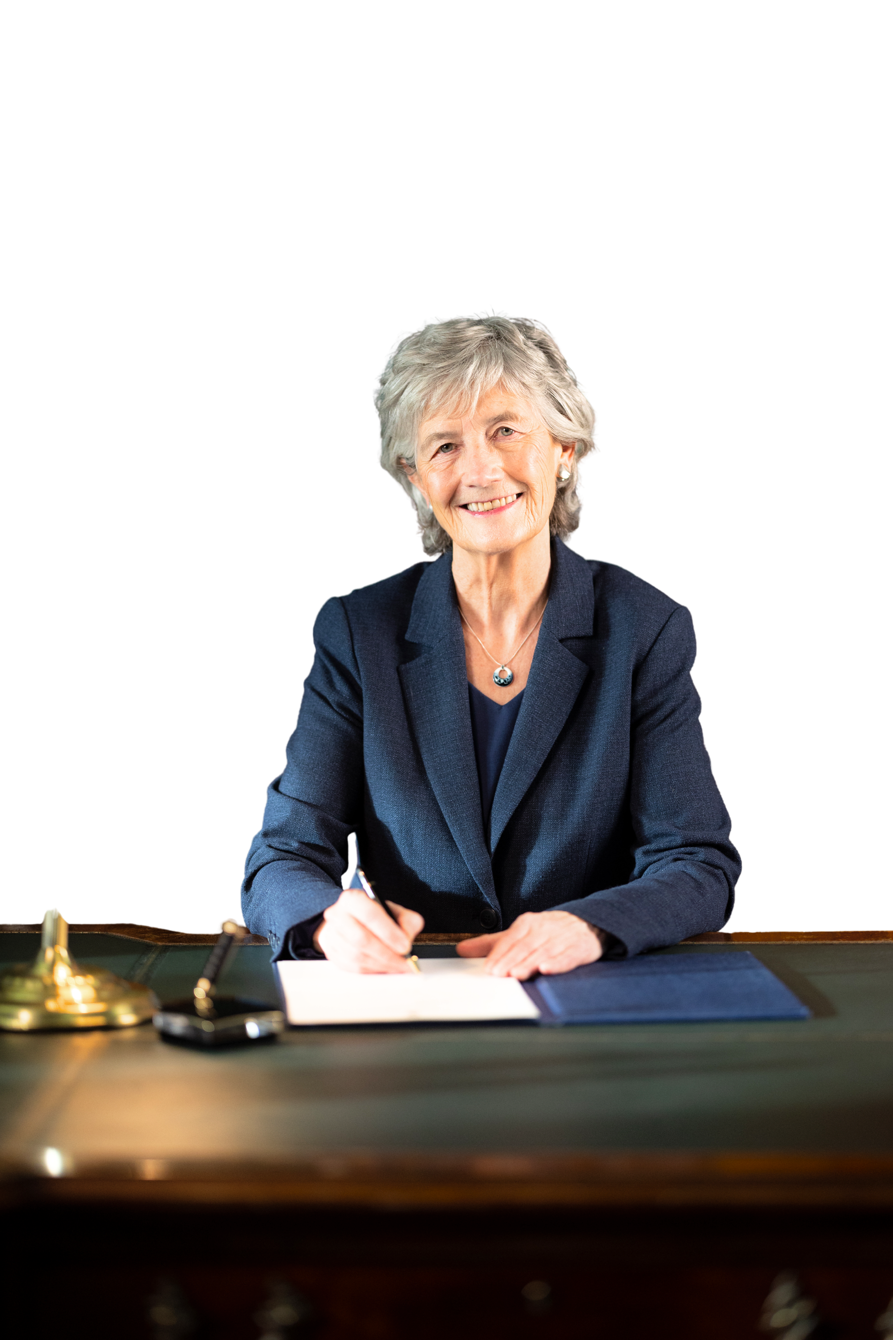
Gaisce – The President’s Award
is Ireland’s National Youth Award
It is a direct challenge from the President of Ireland, Catherine Connolly, for you to realise your potential!

Slide 5

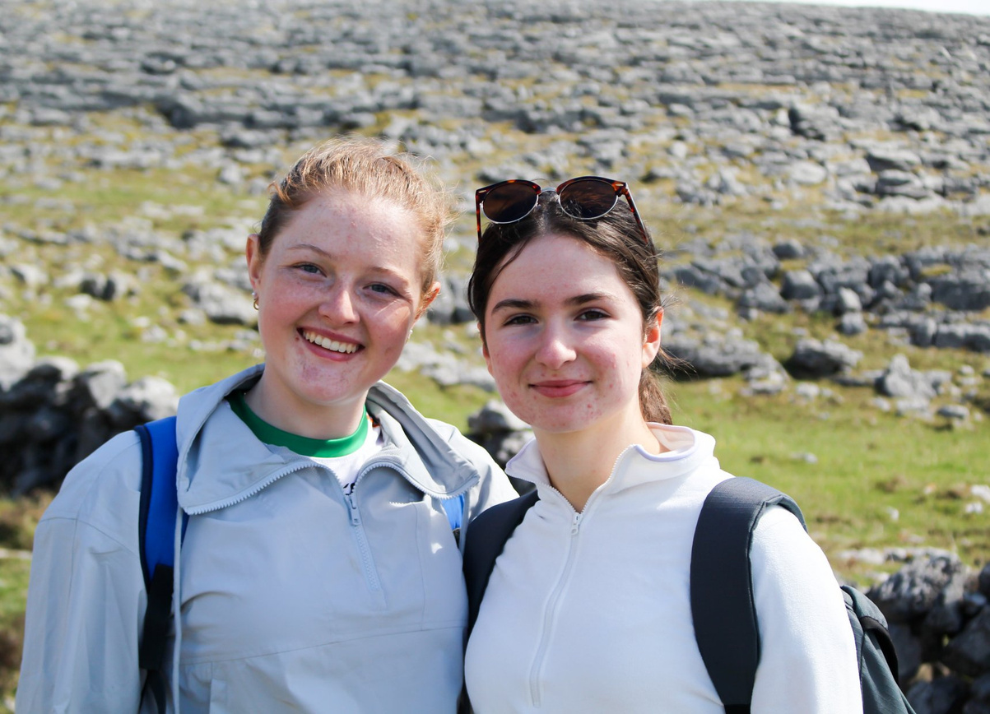
GUIDING PRINCIPLES
Persistence
Balanced
Achievable
Fun
Voluntary
Individual
Progressive
Non-Competitive
Development
Image: Students from Coláiste Chiaráin on their Adventure Journey

Slide 6
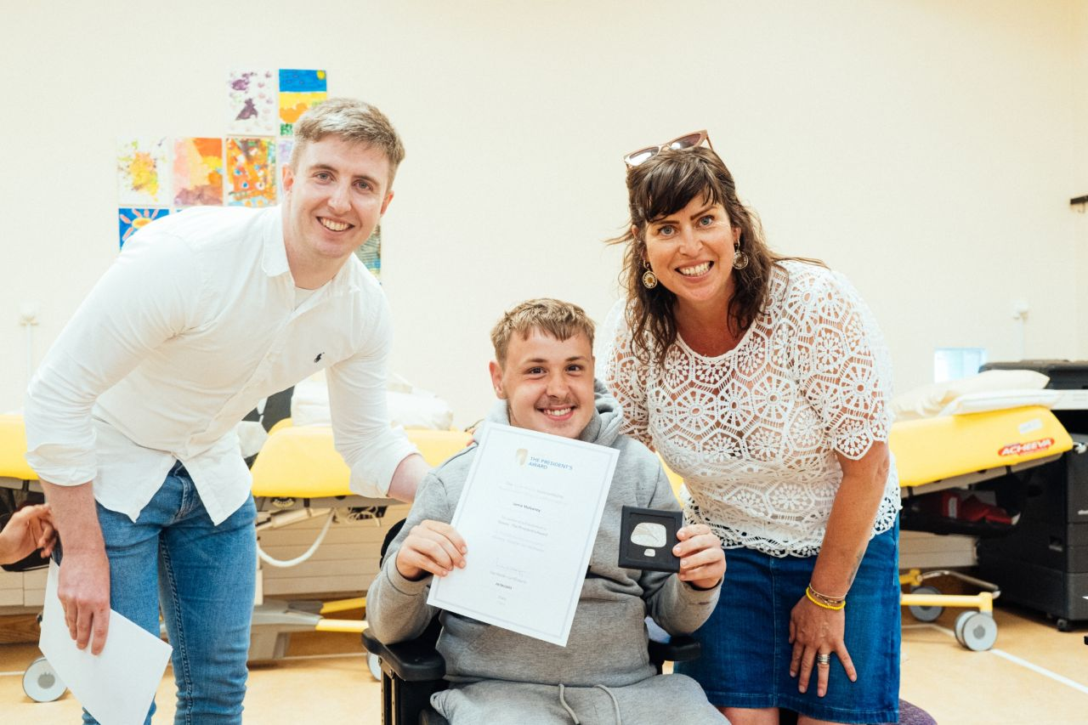

WHO CAN DO GAISCE?
&
MUST BE
Based in
14 - 25
Ireland
years of age
Students
Youth Services & Youth Clubs
Colleges & Third Level Education
Scouts & Guides
Sports Clubs
Youth Reach
Community Training Centres
Disability Groups, Special Schools & more
Image: A participant from Enable Ireland Sandymount School receives his Silver Award

Slide 7




Award levels
BRONZE
SILVER

Slide 8
striving for your Silver Award

Slide 9
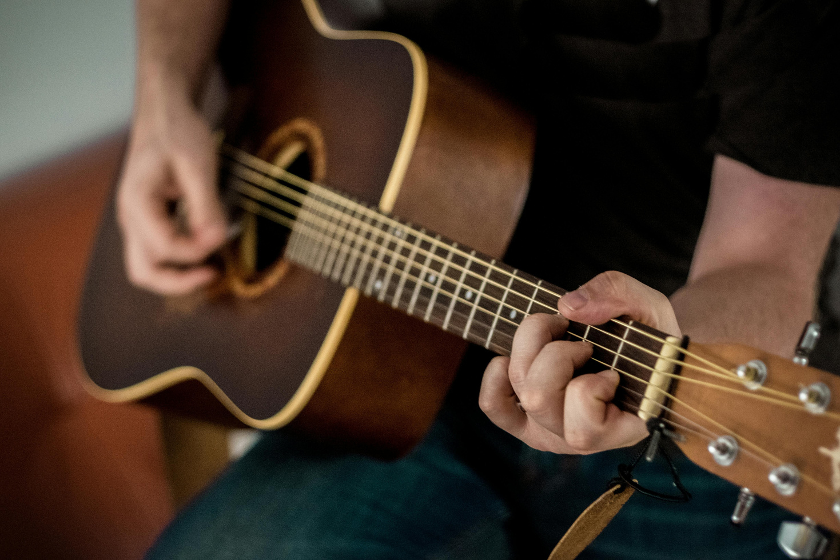
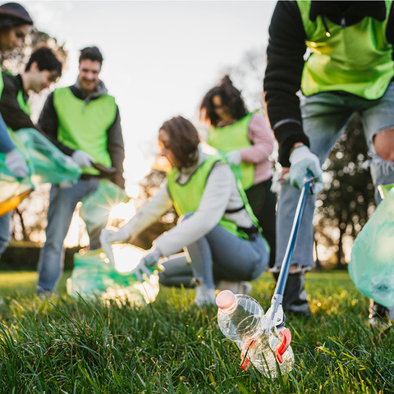
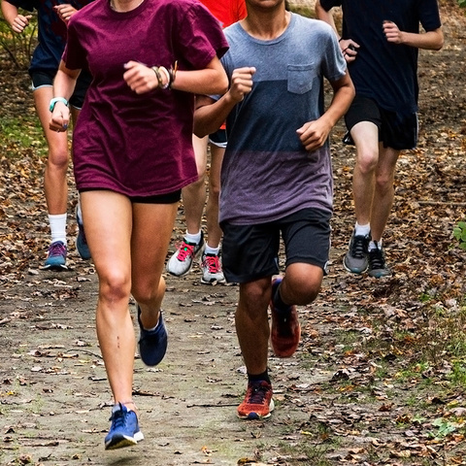
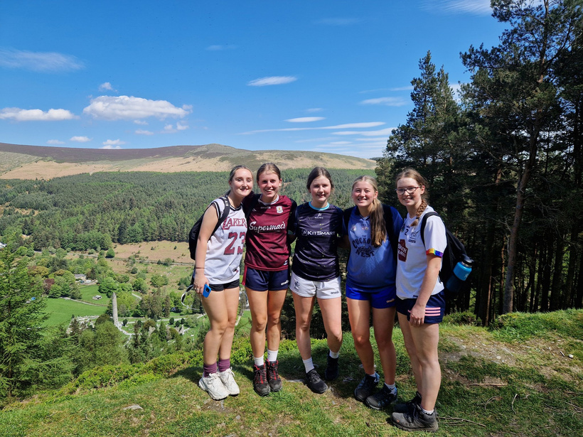
Silver Award
CHALLENGE AREAS
PERSONAL SKILL
COMMUNITY INVOLVEMENT
PHYSICAL RECREATION
ADVENTURE JOURNEY

Slide 10











If you have a Bronze award...
26
To achieve your
Silver Award
Total
weeks
COMMUNITY
INVOLVEMENT
ADVENTURE JOURNEY
26
PERSONAL SKILL
with your Gaisce Group
weeks
PHYSICAL
RECREATION
1
hour of each activity a week
3 days + 2 nights

Slide 11

If you don’t have a Bronze award...
26
additional weeks of one challenge area

Slide 12
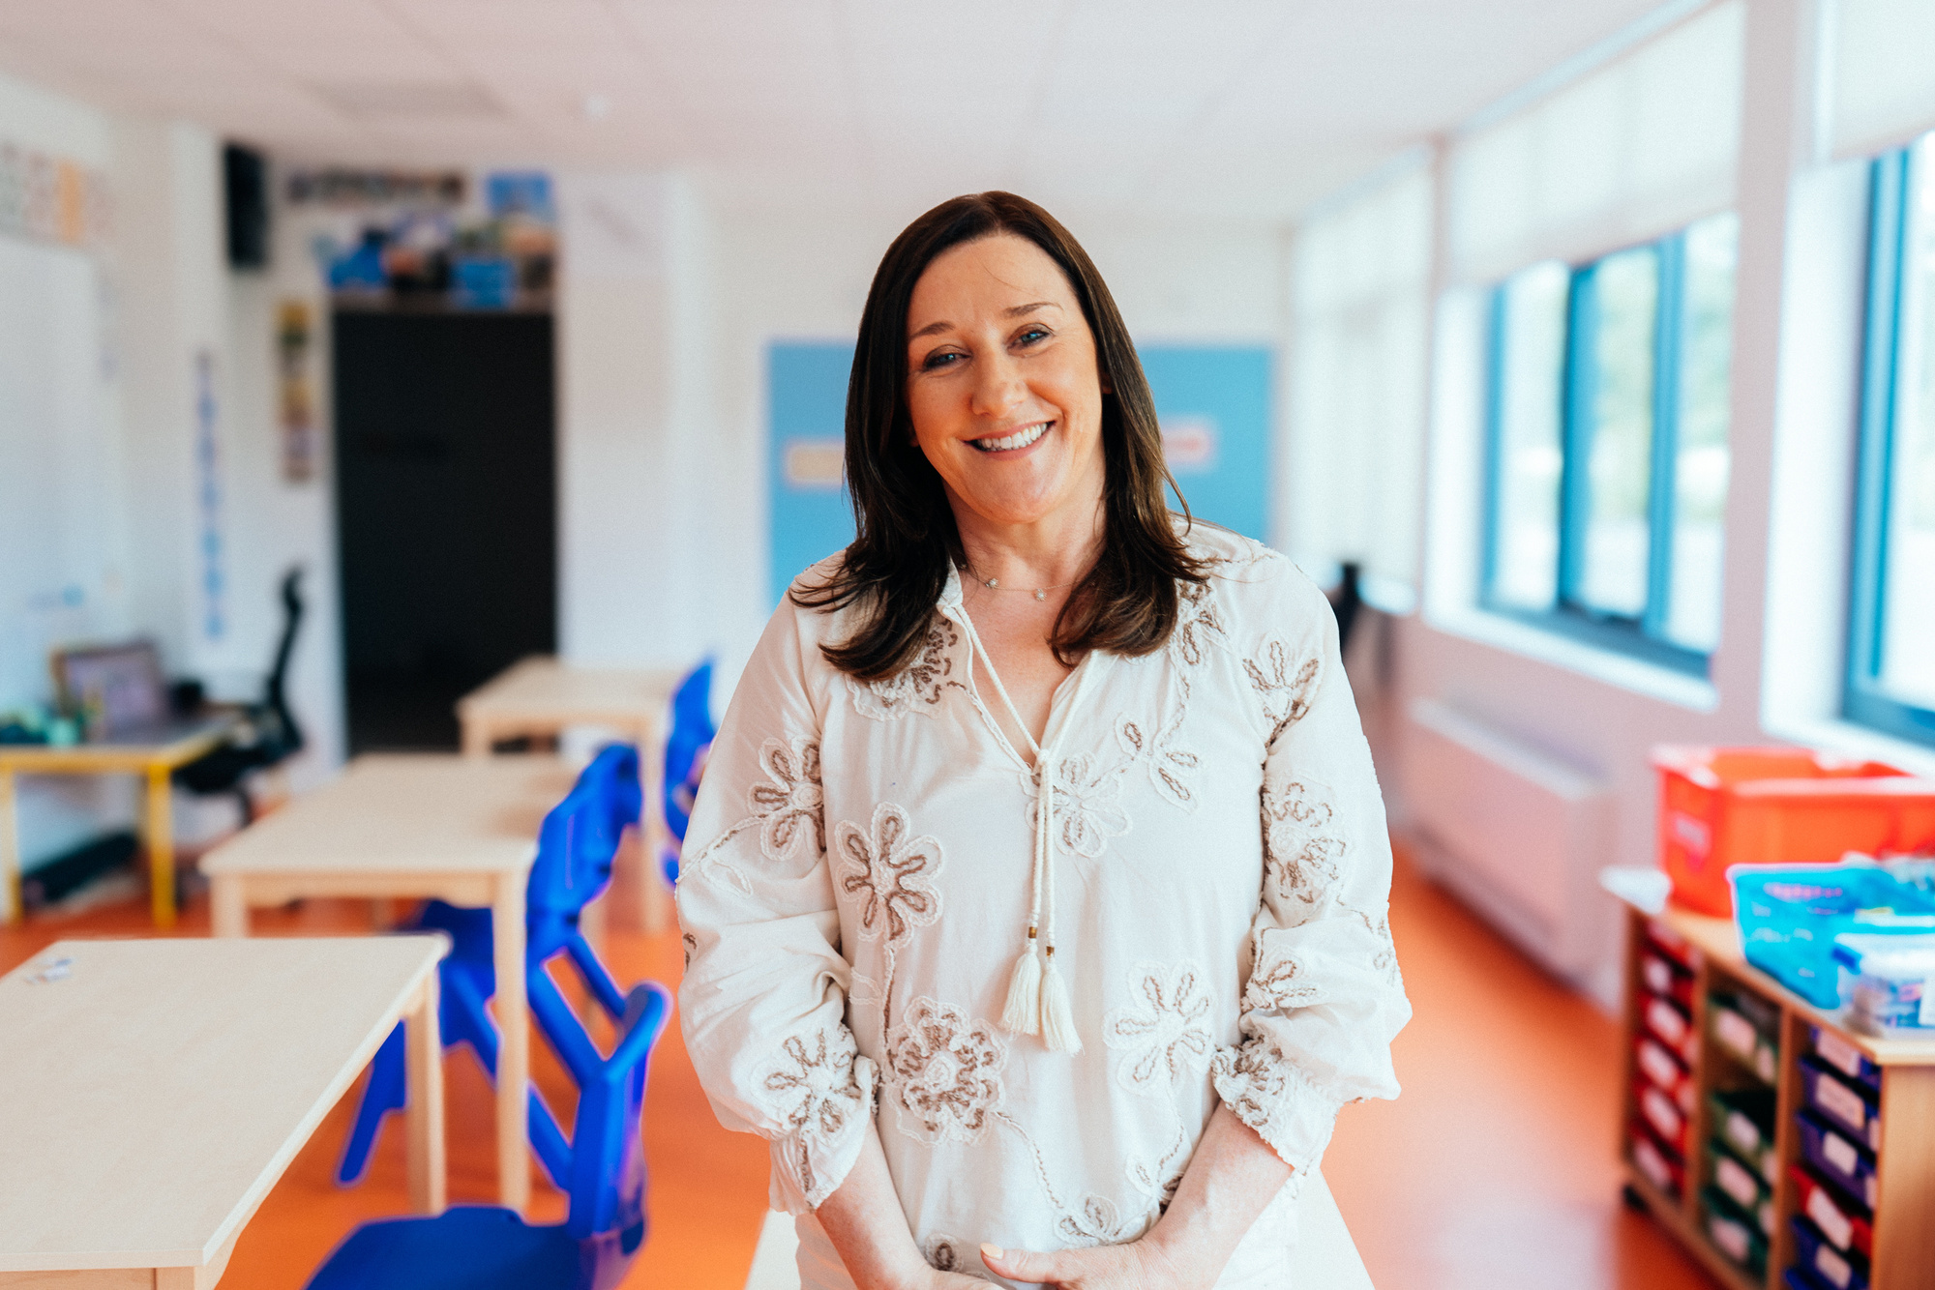
YOUR PAL
Your President’s Award Leader will continue to guide you on your Silver journey
Image: Gaisce PAL Noreena McDonnell from Lakeview Special School

Slide 13
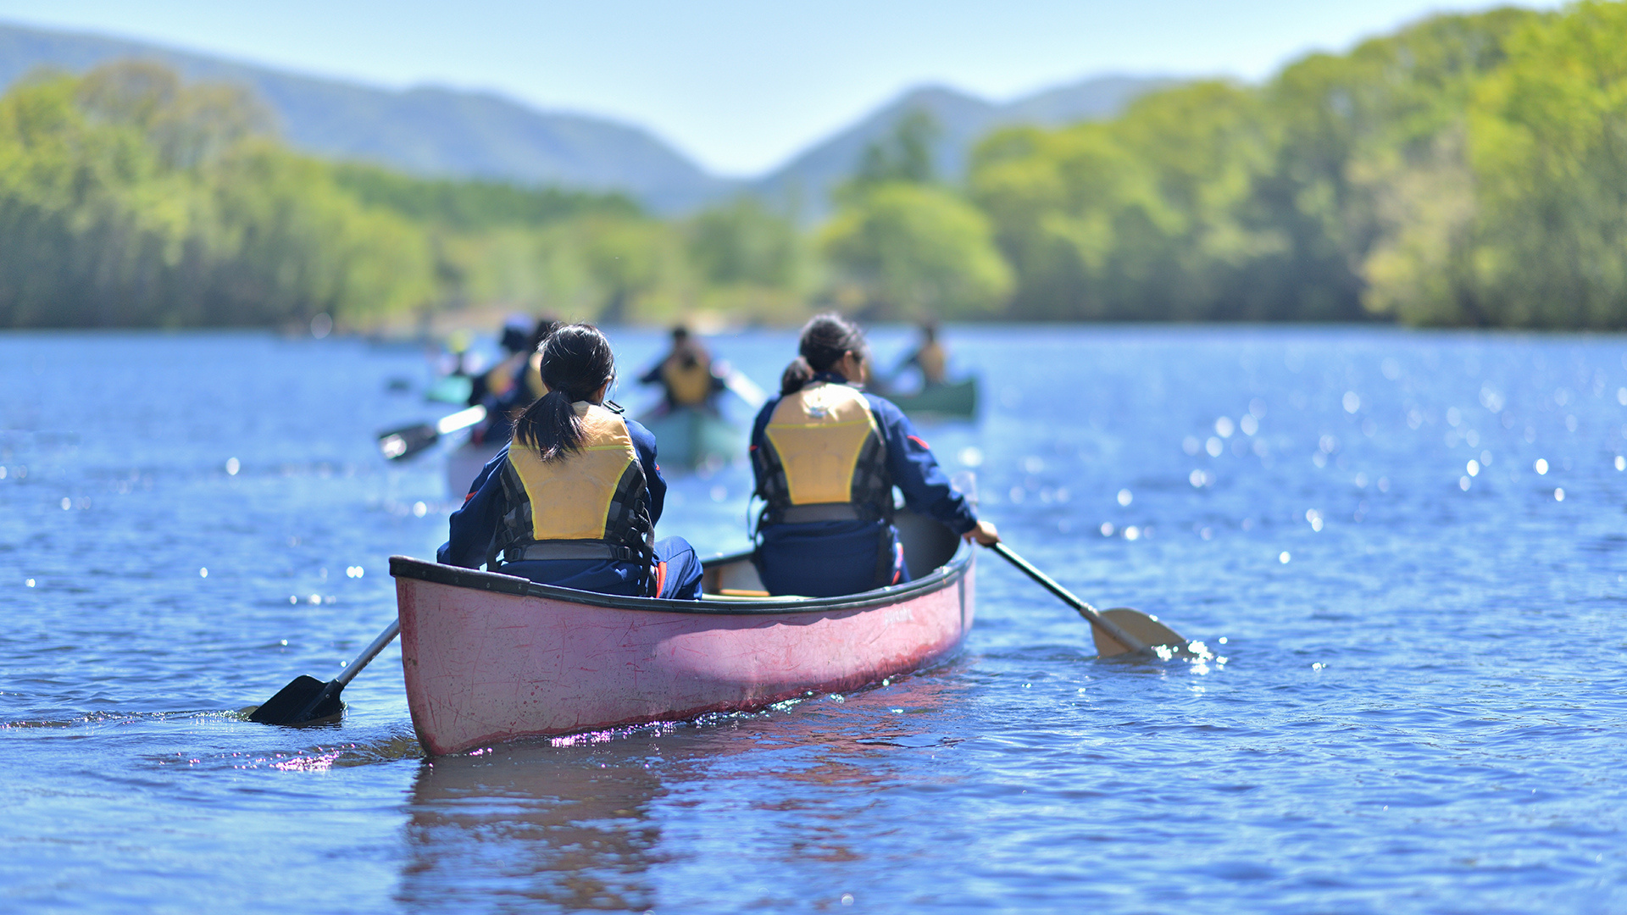
26
weeks
PHYSICAL RECREATION

Slide 14




PHYSICAL RECREATION IDEAS
Sports
Individual
OTHER GOOD STUFF
Exercise class
Parkrun
Yoga / Pilates
Map my Walk / Map my Run
Home gym
Online Workouts
Cycling
Running
CrossFit
Gymnastics
Golf
Skating
Basketball
GAA
Soccer
Cricket
Hockey
Athletics
Rugby
Rowing
Kayaking
Hurling / Camogie
Swimming
Tennis
Boxing
Wheelchair sport
Badminton
Physiotherapy
Going to the Gym
Couch to 5km
Martial Arts
Sailing
Hiking
Dancing
Lifesaving
Archery
BMX
Self-defence
Ultimate Frisby
Table tennis
Horse riding
Roller blading

Slide 15
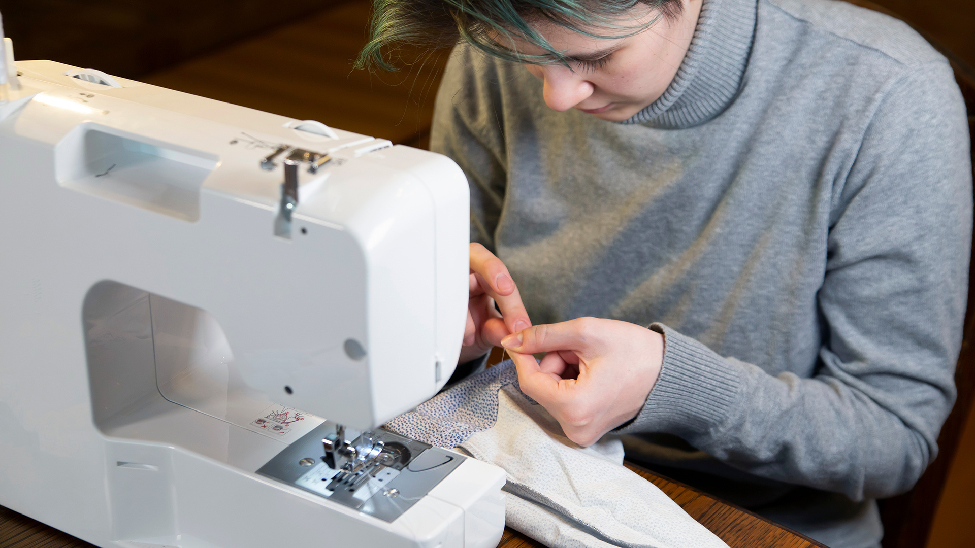
26
weeks
PERSONAL SKILL

Slide 16




PERSONAL SKILL ideas
SCHOOL based
general
OTHER GOOD STUFF
TY Modules that are not the core subjects (ECDL)
Sci Fest
Young Scientist
Junk Couture
Mini Company / Enterprise
YSI
School Band
Chess Club
Debating Club
Self Development Programmes
Baking / Cooking
Arts / Crafts
Knitting
Sewing
Learning an Instrument
Learning a Language (Duo Lingo)
Mindfulness
Yoga
Online Courses
Performance Arts
Film & TV Making
Public Speaking
Photography
Web design
Pool / snooker
Counselling
Barista course
Drama
Dance
Swimming
First Aid
Life Saving
Dog Training
Photography
Costume Design
Poetry
Conservation Skills

Slide 17
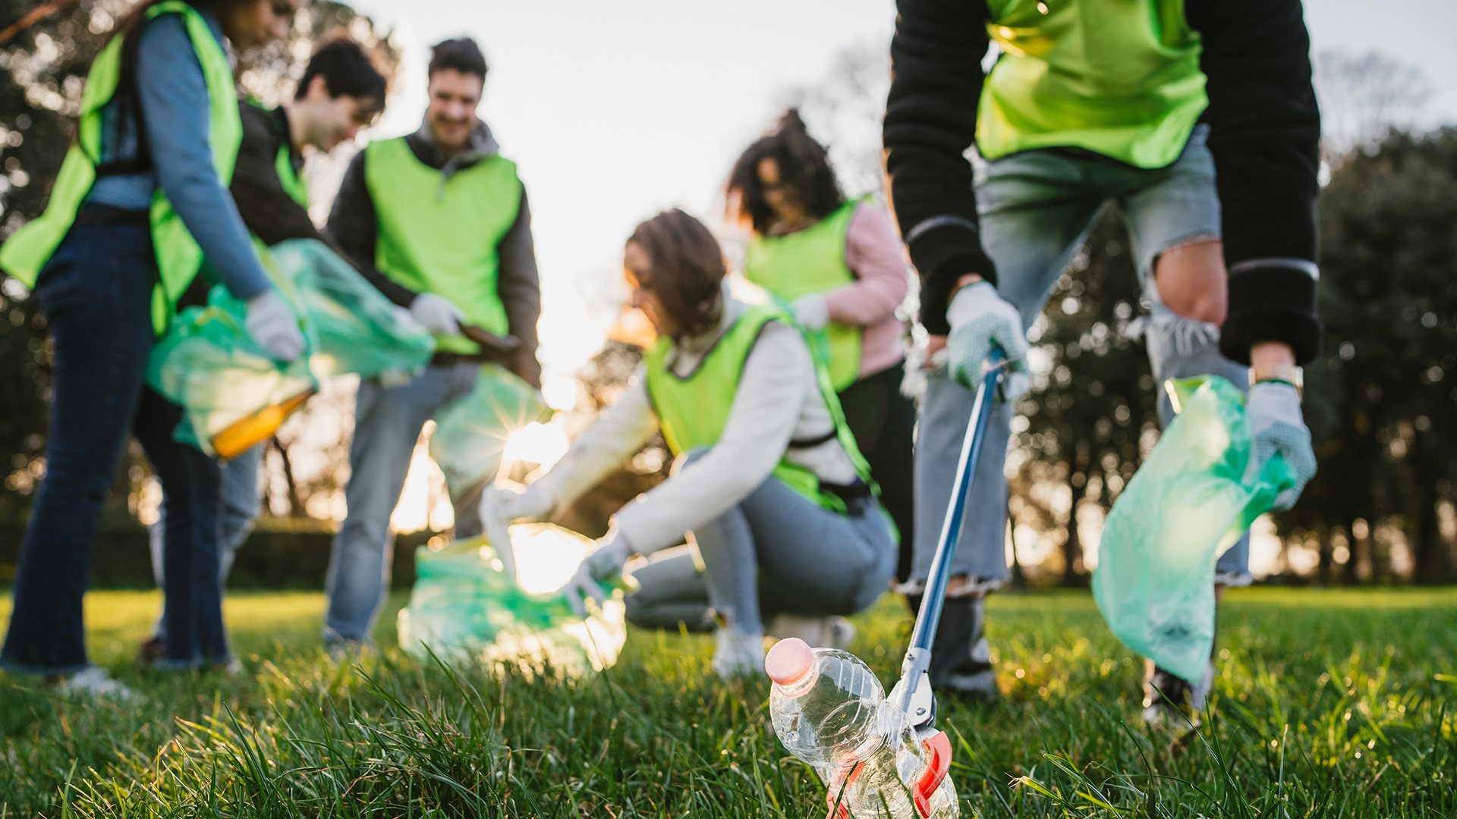
26
weeks
COMMUNITY INVOLVEMENT

Slide 18




COMMUNITY INVOLVEMENT ideas
SCHOOL based
Community
OTHER GOOD STUFF
Buddy / Mentoring System
Green Schools
Amber Flag
Fundraising Committee
School Choir
School Drama Production
Peer Reading
Run a Campaign
Breakfast Clubs
Homework Clubs
School Prefect
School Council
Community Garden
YSI
Library volunteer
Prefect
Peer Coaching with a Sporting Club (GAA, soccer)
Tidy Towns
Community Garden
Charity Shop Volunteer
Animal Shelter Volunteer
Walking Elderly Neighbours Dog
Shopping for an Elderly Neighbour
Joining a campaign group, e.g. climate action group
Visiting a Nursing Home
Volunteer with a community group
Church choir
Parkrun race marshal
Order of Malta
Youth Club Volunteer
Girl Guide Volunteer
Scout Volunteer
Youth Leadership Course
Join a college society/club
Student’s Union

Slide 19
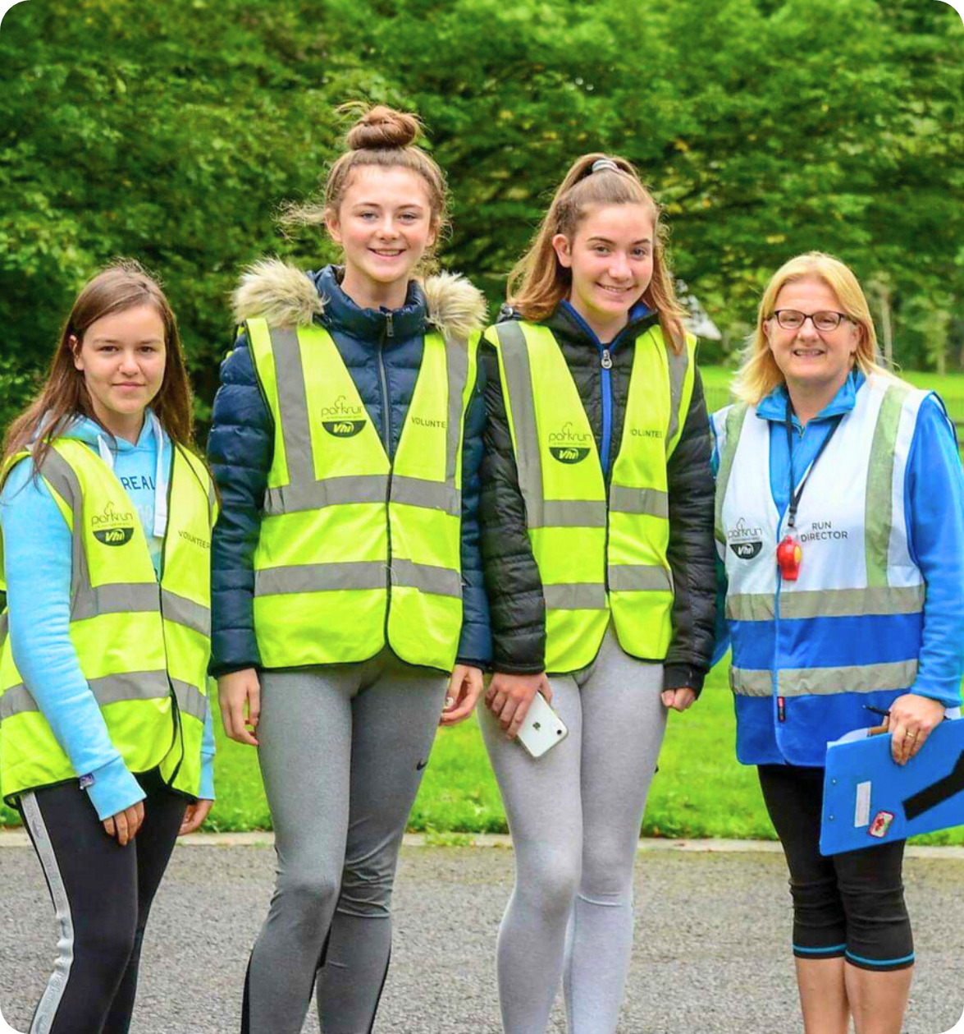
Challenge Partners
Image: Gaisce participants volunteering with Parkrun for their community involvement

Slide 20
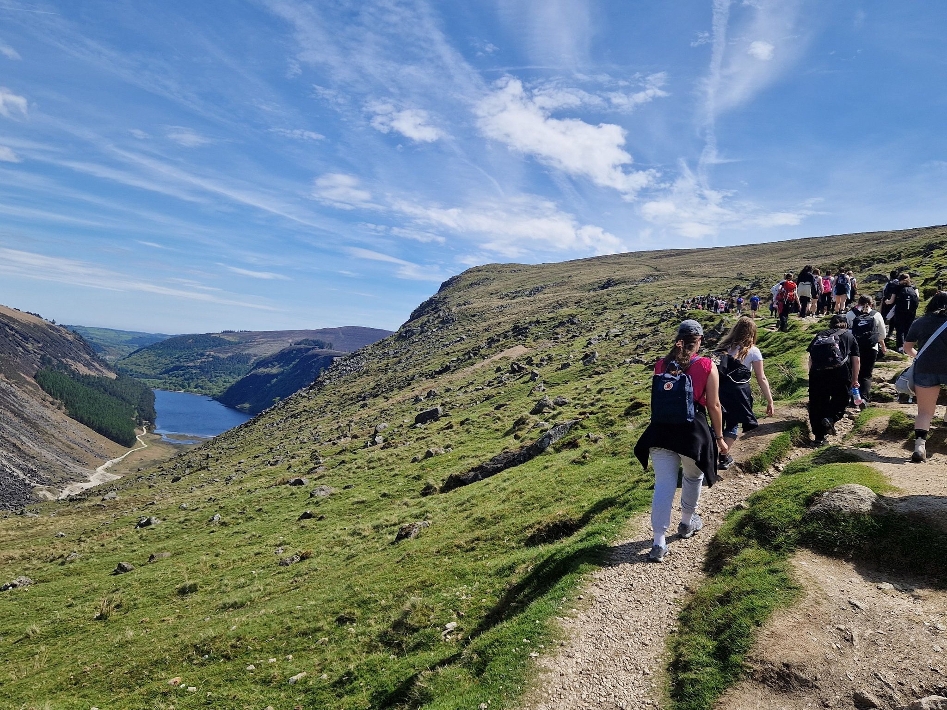
Silver ADVENTURE JOURNEY
Image: Gaisce participants from St Mary’s College, Naas on their Adventure Journey

Slide 21
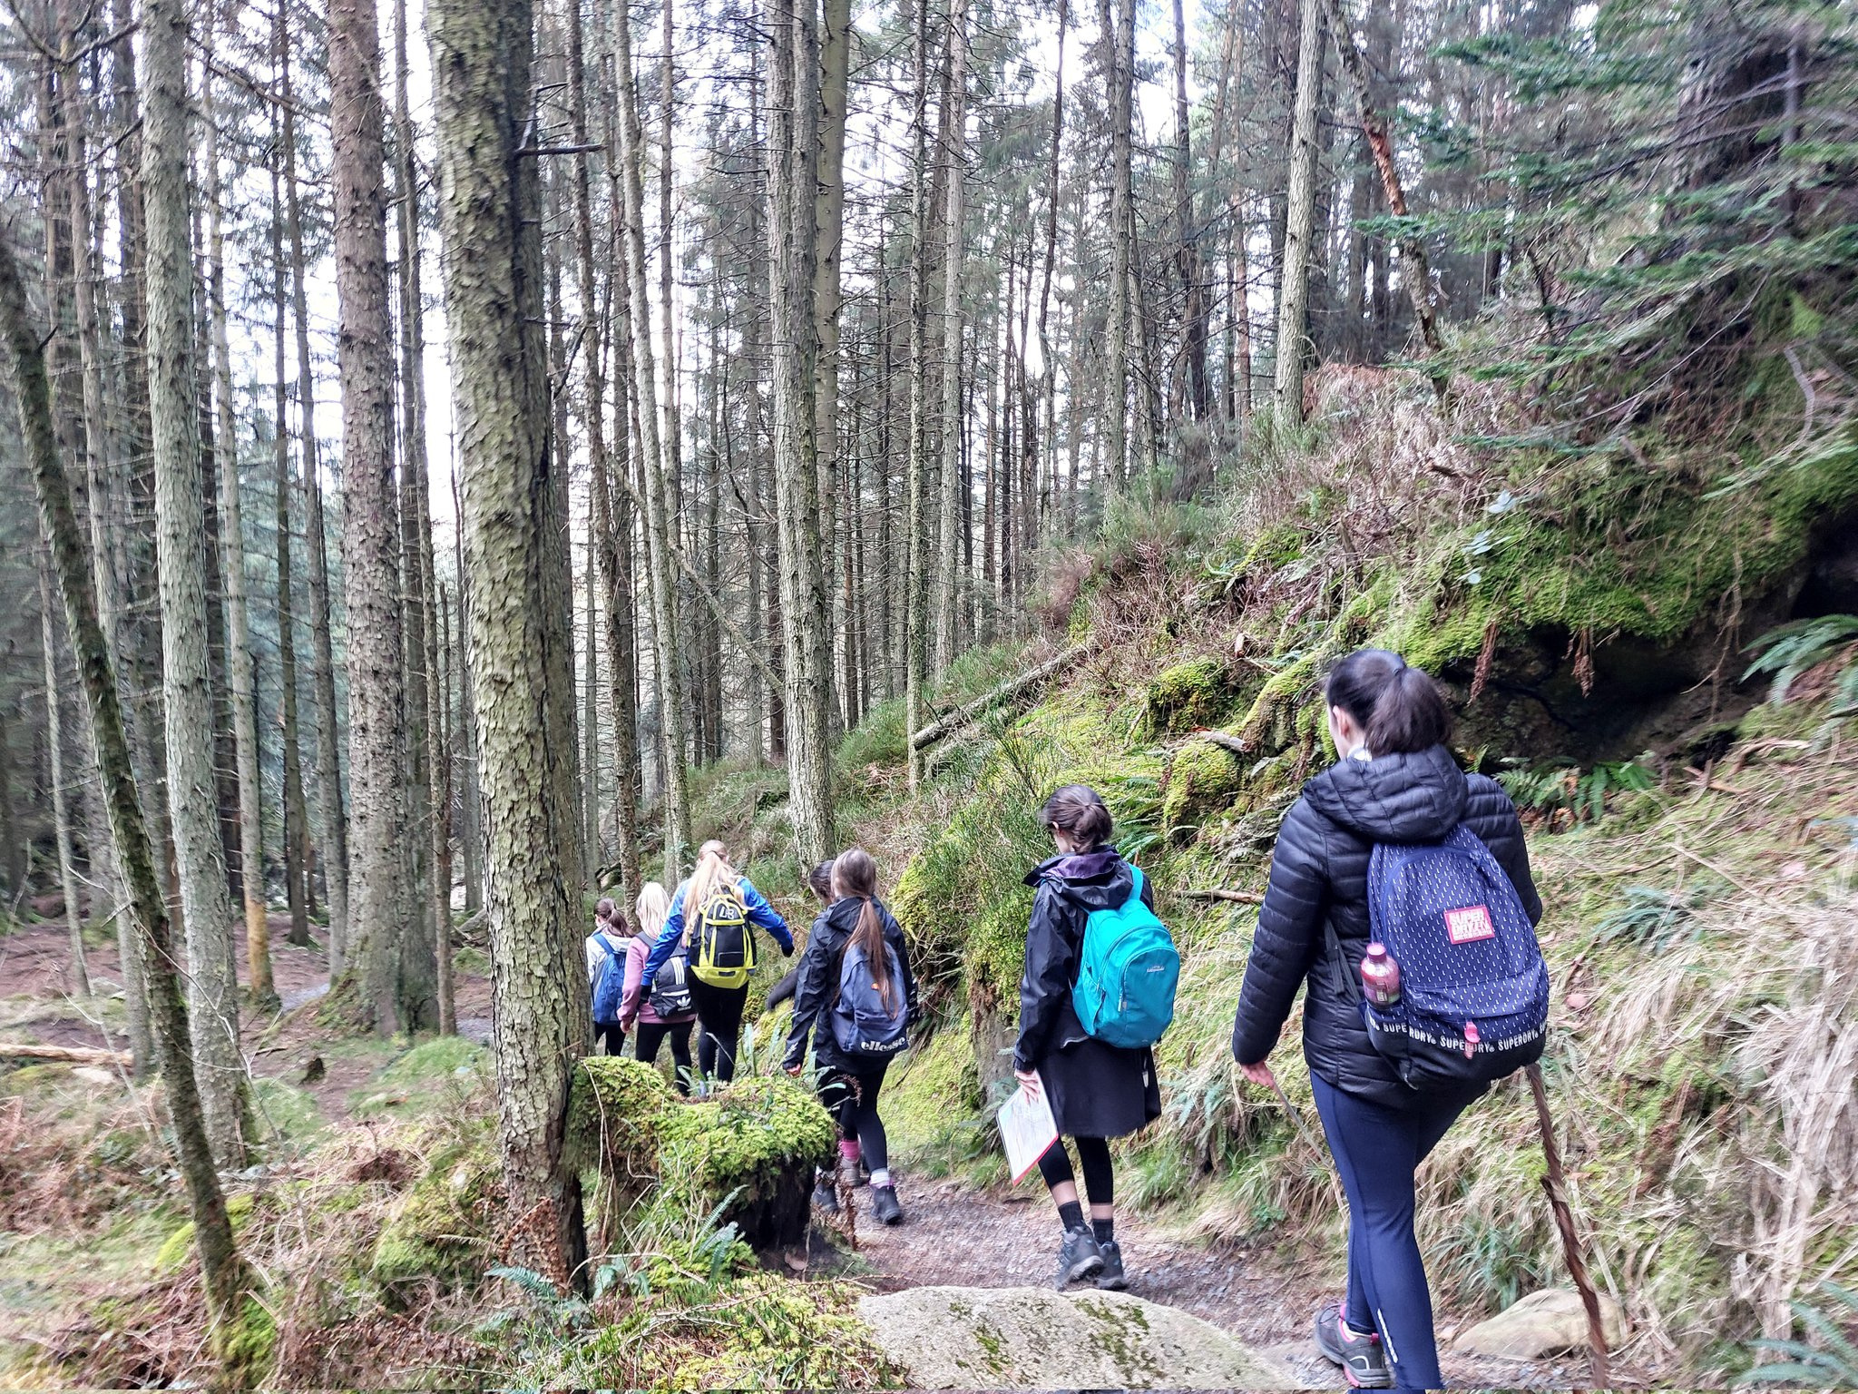
SILVER
3 days + 2 nights
Distance
50km walking or
190km cycling or
7 hours of meaningful activity per day
(suggested)
Must be completed over
3 consecutive days

Slide 22
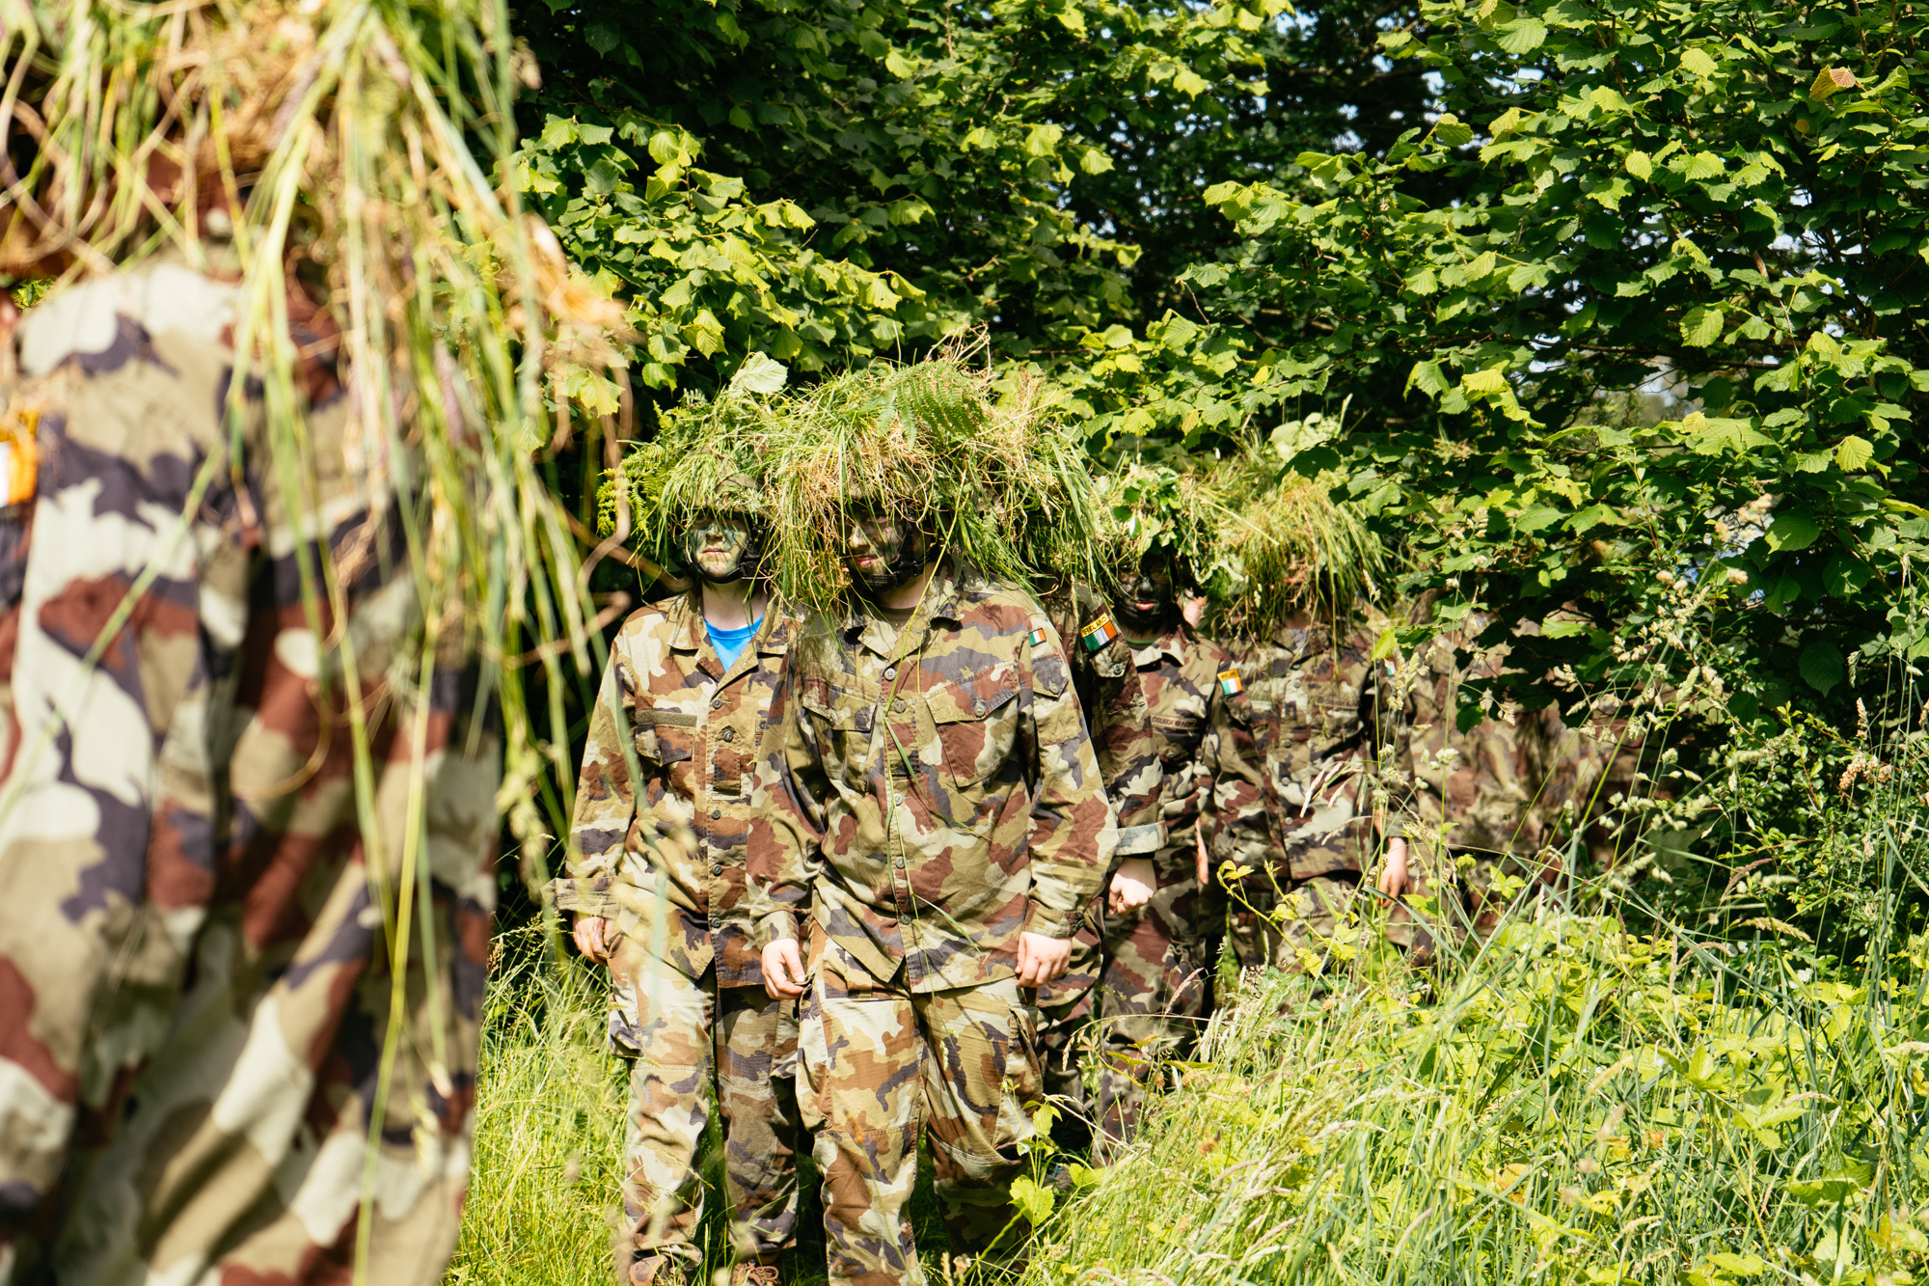
Defence Forces Challenge
Image: Silver Gaisce participants take part in the Defence Forces Challenge

Slide 23


EXAMPLE
Silver GAISCE AWARD
PERSONAL
SKILL
PHYSICAL RECREATION
COMMUNITY INVOLVEMENT
ADVENTURE JOURNEY / EXPEDITION
Learning to cook
Basketball
Community Garden volunteer
Waterford Greenway
1 hour per week
for 26 weeks
1 hour per week
for 26 weeks
1 hour per week
for 26 weeks
3 days & 2 night

Slide 24











CHALLENGE AREA’S
DEVELOP ONE CHALLENGE AREA
AWARD
LEVEL
Physical
Recreation
Personal
Skill
Community
Involvement
ADVENTURE JOURNEY
Pick an activity for
each challenge area
13
1
13
BRONZE
AWARD
for
2
1
hour of each per week
weeks
days
14+
€15
Continue
one challenge area
Min age
Registration
weeks
night
1
26
26
SILVER AWARD
for
3
2
hour of each per week
weeks
If no
Bronze
Award
days
15+
€20
RESIDENTIAL
PROJECT
Min age
Registration
weeks
Continue
one challenge area
nights
PORTFOLIO
1
26
52
GOLD AWARD
for
4
3
5
4
hour of each per week
weeks
days
days
If no
Silver
Award
17+
€25
Continue
one challenge area
Min age
Registration
weeks
nights
nights

Slide 25

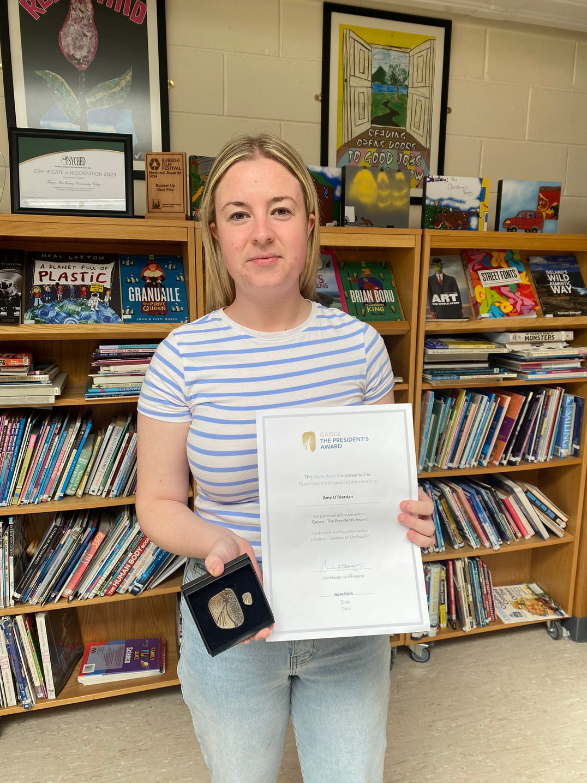
WHY DO IT ?
Self belief, confidence and resilience
An independent and self-motivating attitude
A positive connection and contribution to
local community
New & improved interests & abilities
Nationally & internationally recognised award
Looks good on a CV
Image: Silver awardee from Terence McSwiney Community College

Slide 26

THINK ABOUT
What do you want to do in each challenge area?
Will it last 26 weeks?
Who will vouch for you / sign off?
If you don’t have a Bronze award, what will you choose for your additional 26 weeks?

Slide 27
GET REGISTERED for Silver
1
Find a PAL in your school / organisation who will support you throughout the course of the award.
2
Select your activities for each section of the Silver award.
3
Agree your activities with your PAL.
4
Agree with your PAL how you will pay to register - either yourself or via your PAL.

Slide 28


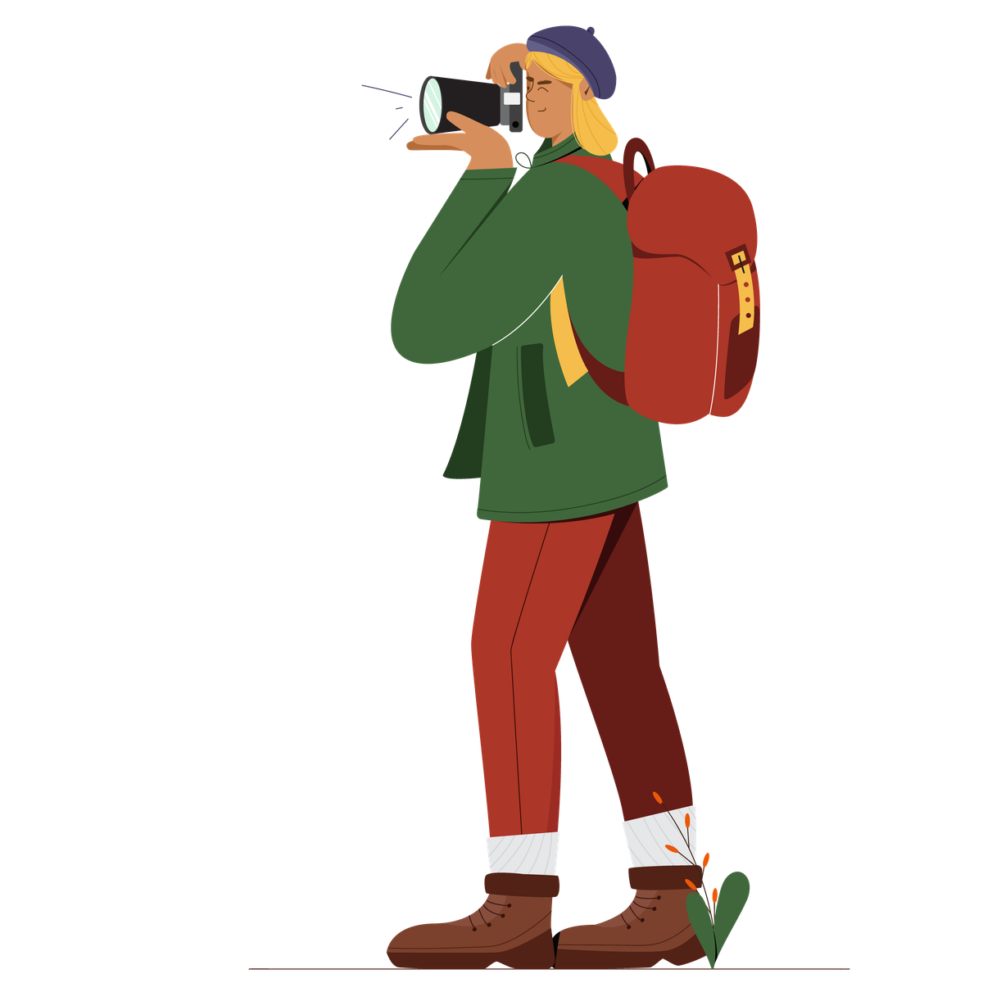
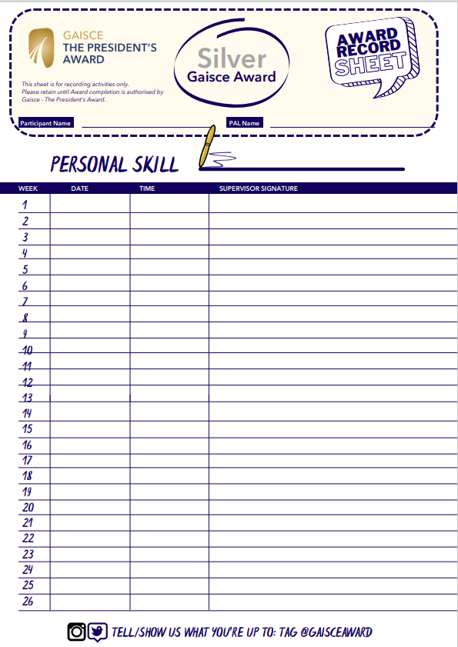



TRACK PROGRESS
JOURNAL

Slide 29


Slide 30
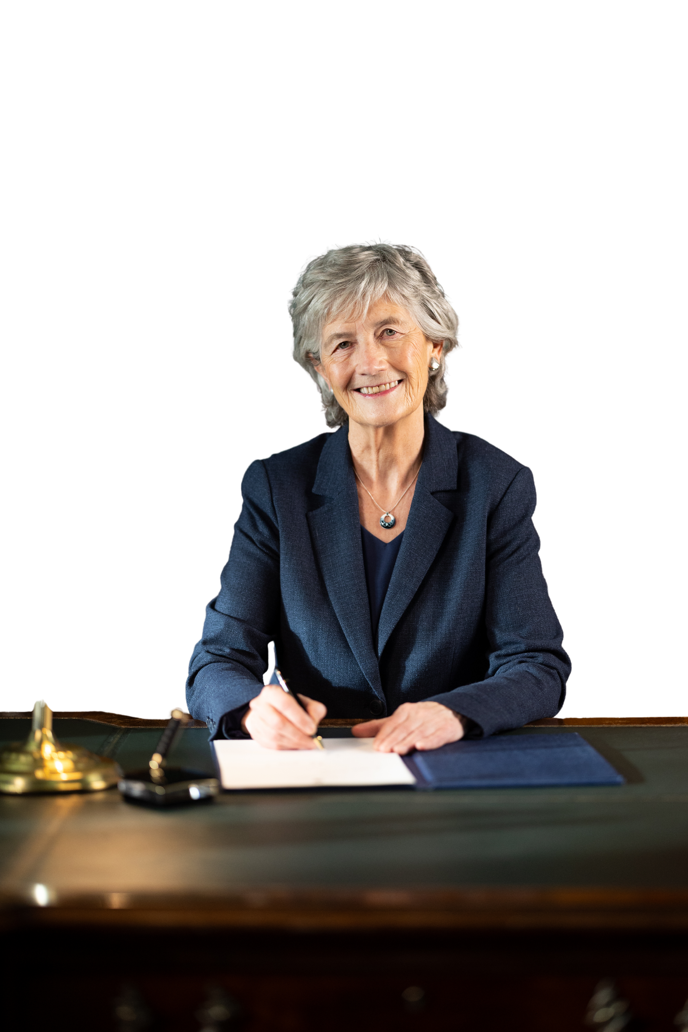
/
LA GAISCE
21st October
#LáGaisce

Slide 31

CONFIDENCE
DEVELOPEMNT
You are not comparing yourself to anyone;
FUN
SKILLS
You are not competing with anyone;
What you are actually doing is
CREATING YOURSLEF

Slide 32

?
Question &
Answers

Slide 33
Thank You

