Slide 1
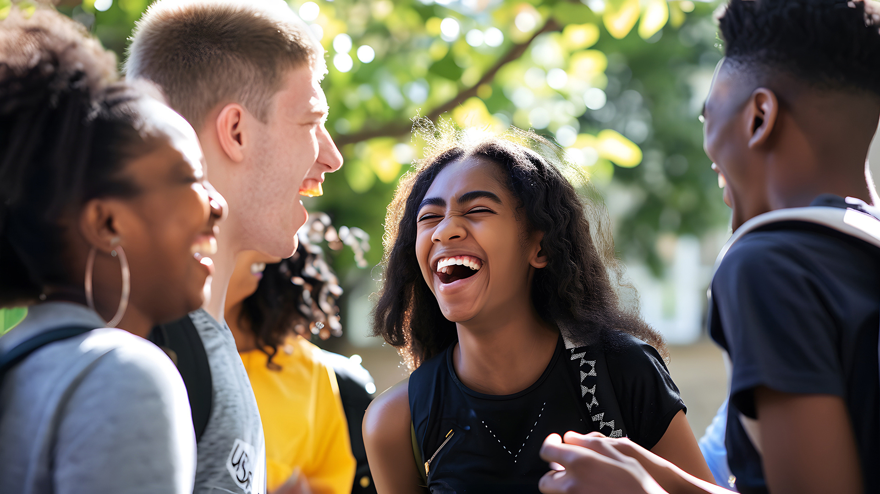




YOUR WAY, YOUR AWARD!
@GaisceAward

Slide 2


Slide 3


WHAT IS THE GAISCE AWARD?
A self-development programme for young people between the ages of 14 - 25 in Ireland.
Non–Formal
Non–Competitive
Self–Directed

Slide 4



It is a direct challenge from
the President of Ireland,
Catherine Connolly for you to...
DREAM BIG
AND REALISE
YOUR POTENTIAL

Slide 5
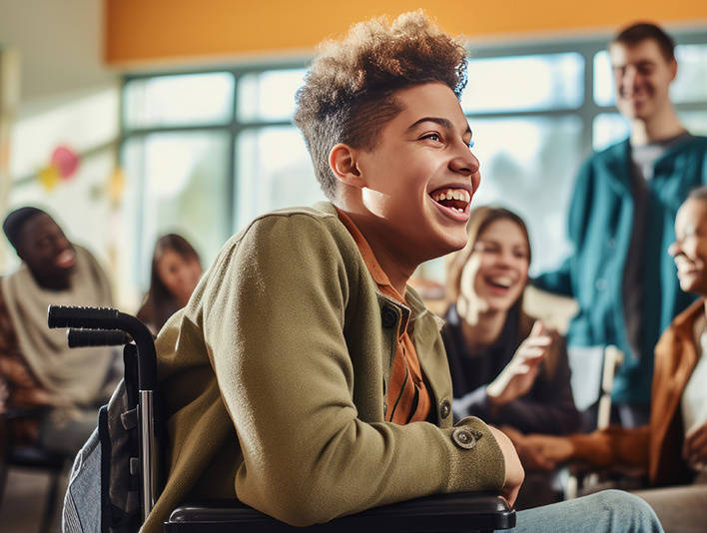

WHO CAN DO GAISCE?
&
MUST BE
Based in
14 - 25
Ireland
years of age
Students
Youth Services & Youth Clubs
Colleges & Third Level Education
Scouts & Guides
Sports Clubs
Youth Reach
Community Training Centres
Disability Groups, Special
Schools & more

Slide 6

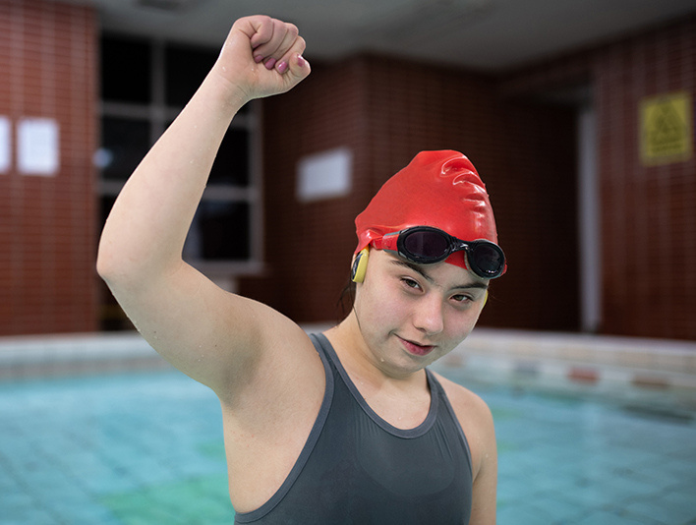
GUIDING PRINCIPLES
Persistence
Balanced
Achievable
Fun
Voluntary
Individual
Progressive
Non-Competitive
Development

Slide 7

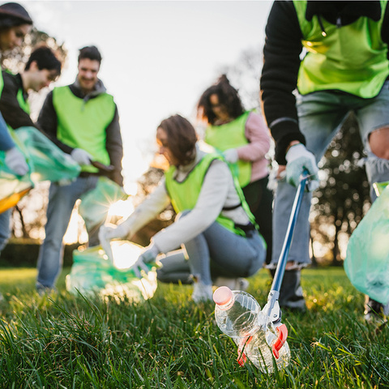
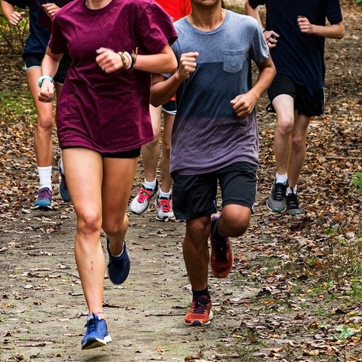
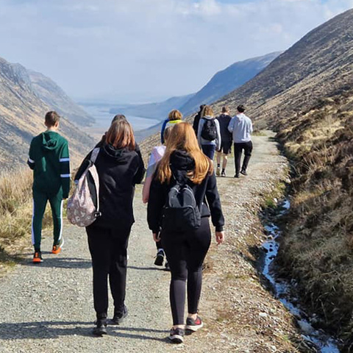
GAISCE
CHALLENGE AREAS !
PERSONAL SKILL
COMMUNITY INVOLVEMENT
PHYSICAL RECREATION
ADVENTURE JOURNEY

Slide 8
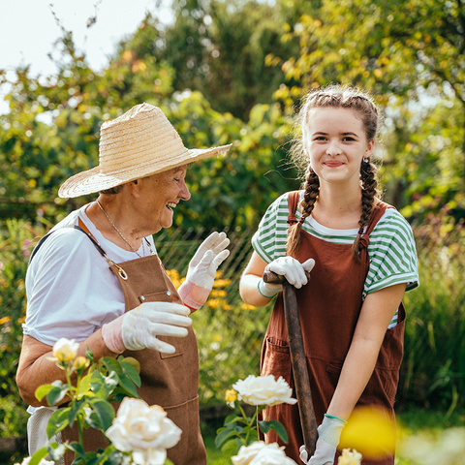
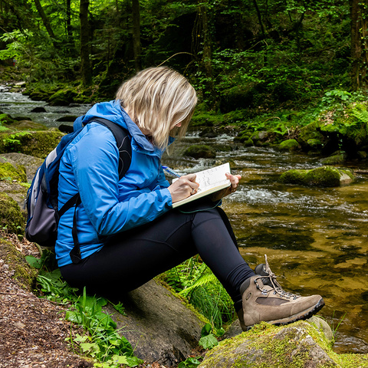
Gold
Award
Only
GAISCE
CHALLENGE AREAS !
RESIDENTIAL PROJECT
GOLD PORTFOLIO

Slide 9



AWARDS LEVELS
BRONZE
SILVER
GOLD

Slide 10











26
To achieve your
BRONZE
AWARD
Total
Plus
weeks
COMMUNITY
INVOLVEMENT
13
ADVENTURE JOURNEY
PERSONAL SKILL
with your Gaisce Group
weeks
PHYSICAL
RECREATION
13
1
Continue with your favourite activity from the first 13 weeks!
hour of each activity a week
weeks
2 days + 1 night

Slide 11
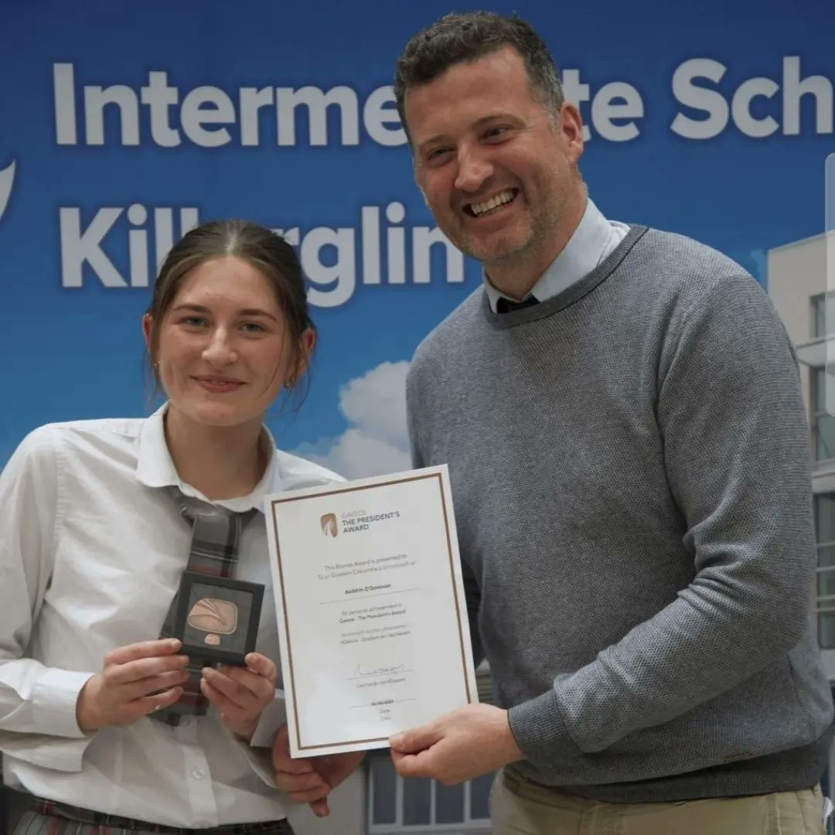
YOUR PAL
You will have a President’s Award Leader to guide you on your journey

Slide 12
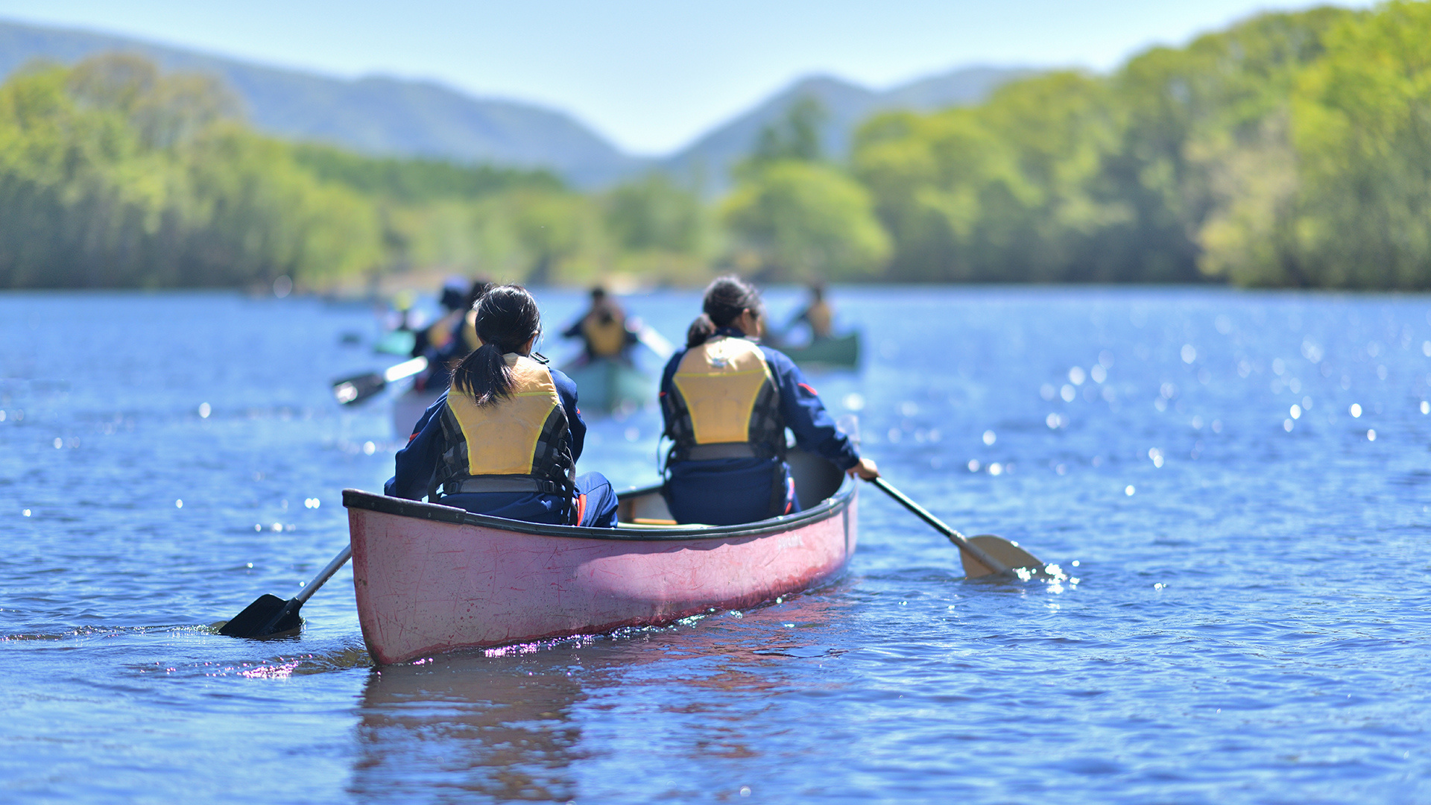
PHYSICAL RECREATION

Slide 13

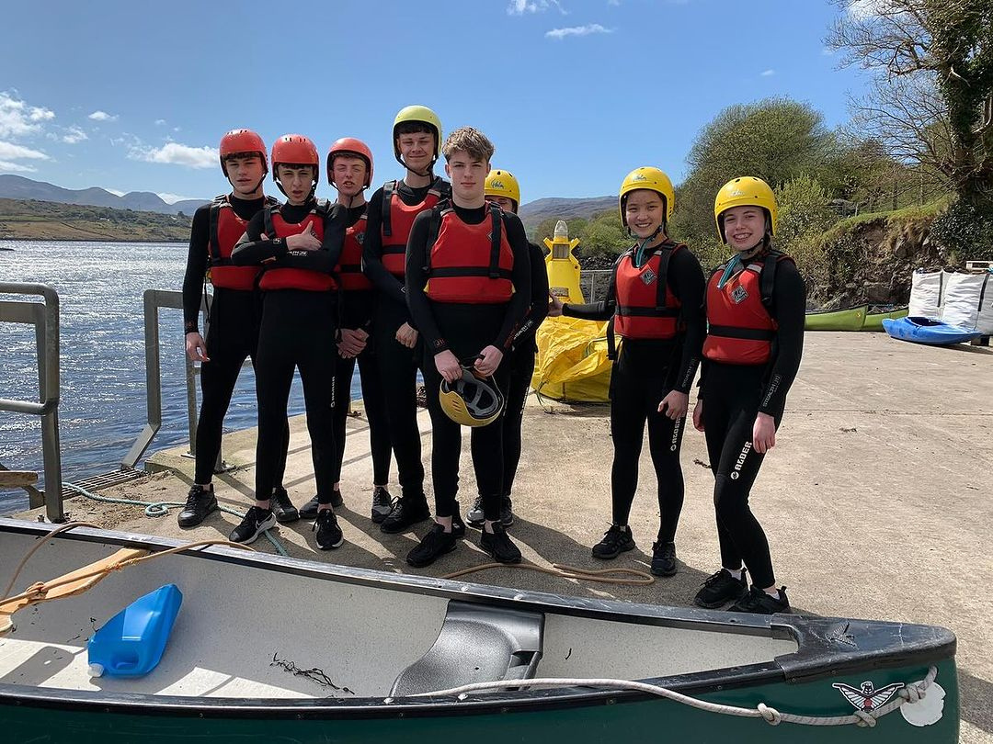
PHYSICAL RECREATION
For your physical health and wellbeing
Being active!
A new physical activity or something you already enjoy
Individually or part of a team / group

Slide 14



PHYSICAL RECREATION
Sports
Individual
OTHER GOOD STUFF
Exercise class
Parkrun
Yoga / Pilates
Map my Walk / Map my Run
Home gym
Online Workouts
Cycling
Running
CrossFit
Gymnastics
Golf
Skating
Basketball
GAA
Soccer
Cricket
Hockey
Athletics
Rugby
Rowing
Kayaking
Hurling / Camogie
Swimming
Tennis
Boxing
Wheelchair sport
Badminton
Physiotherapy
Going to the Gym
Couch to 5km
Martial Arts
Sailing
Hiking
Dancing
Lifesaving
Archery
BMX
Self-defence
Ultimate Frisby
Table tennis
Horse riding
Roller blading

Slide 15
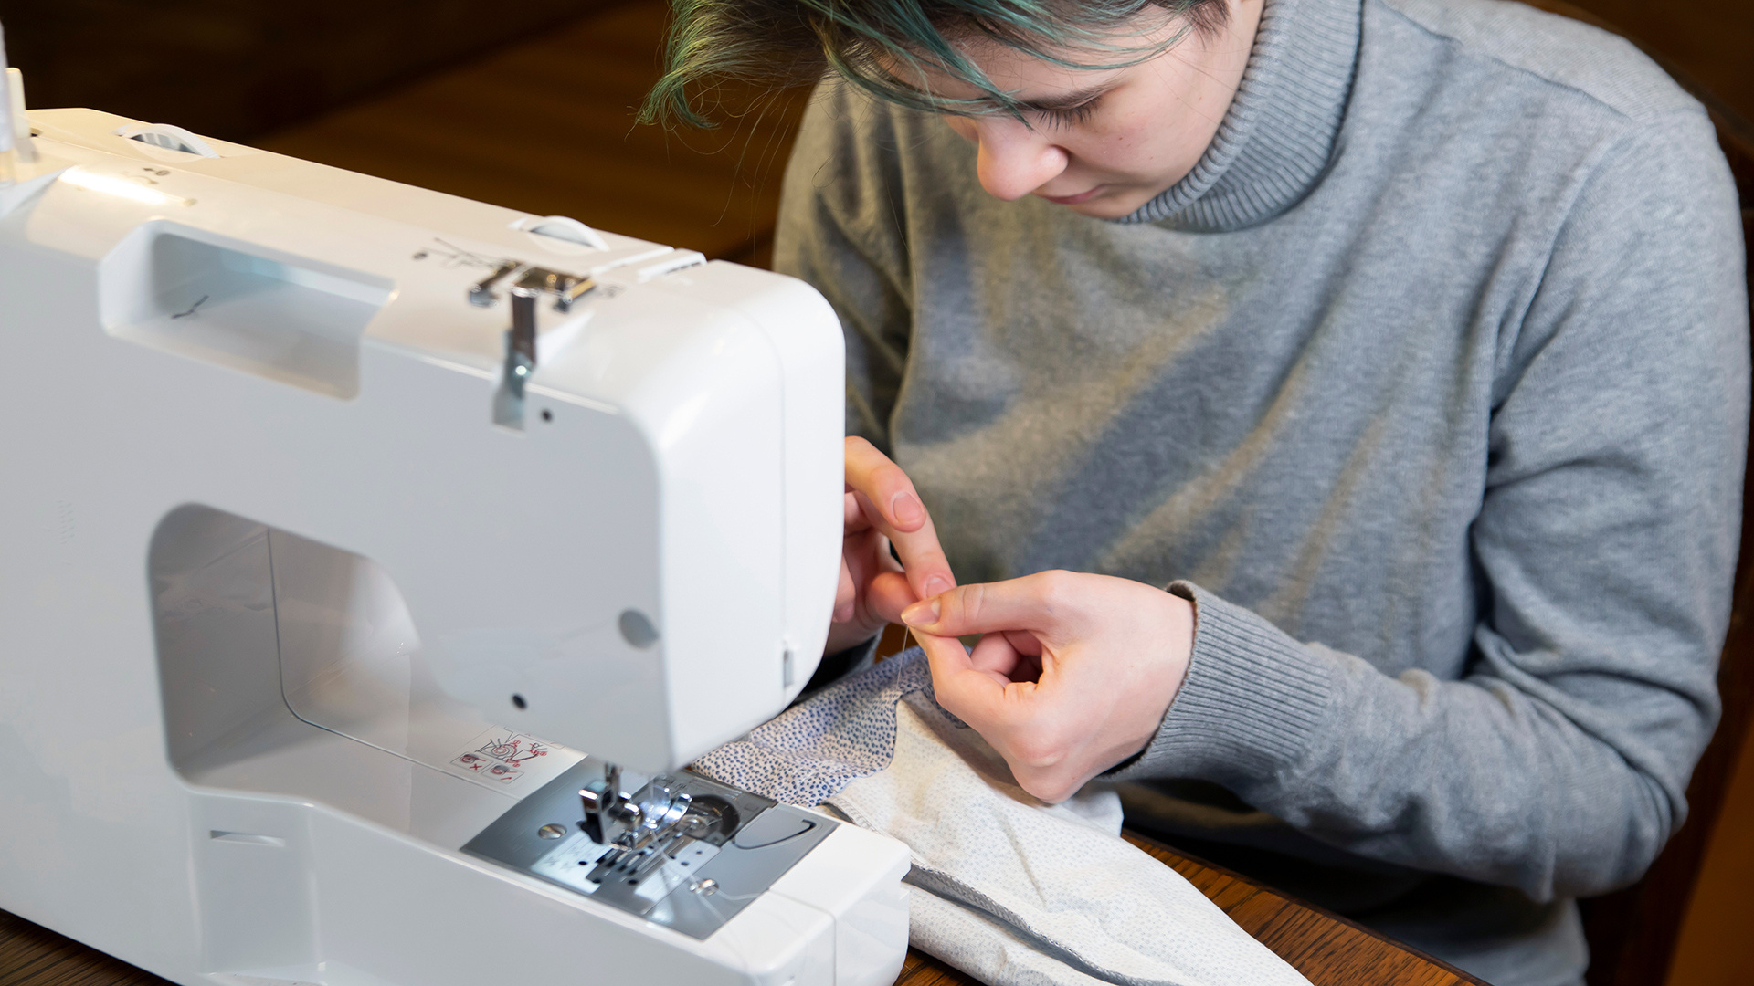
PERSONAL SKILL

Slide 16

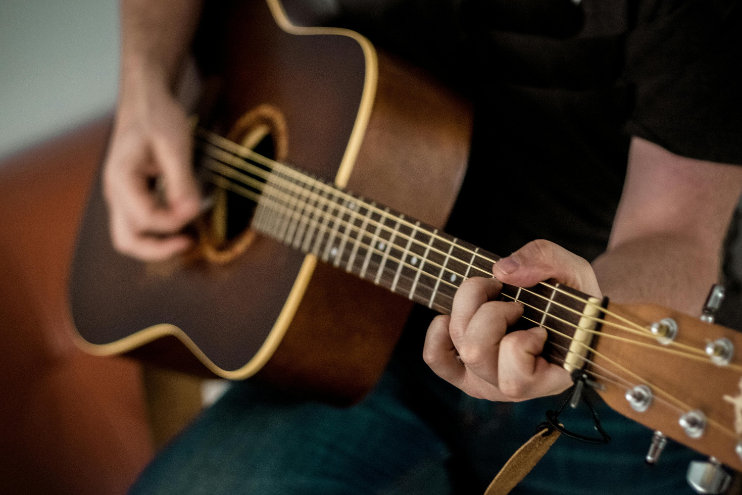
PERSONAL SKILL
Explore your talents, interests and abilities
Develop an existing skill or try something new that interests you
Individually or part of a team / group

Slide 17



PERSONAL SKILL
SCHOOL based
general
OTHER GOOD STUFF
TY Modules that are not the core subjects (ECDL)
Sci Fest
Young Scientist
Junk Couture
Mini Company / Enterprise
YSI
School Band
Chess Club
Debating Club
Self Development Programmes
Baking / Cooking
Arts / Crafts
Knitting
Sewing
Learning an Instrument
Learning a Language (Duo Lingo)
Mindfulness
Yoga
Online Courses
Performance Arts
Film & TV Making
Public Speaking
Photography
Web design
Pool / snooker
Counselling
Barista course
Drama
Dance
Swimming
First Aid
Life Saving
Dog Training
Photography
Costume Design
Poetry
Conservation Skills

Slide 18
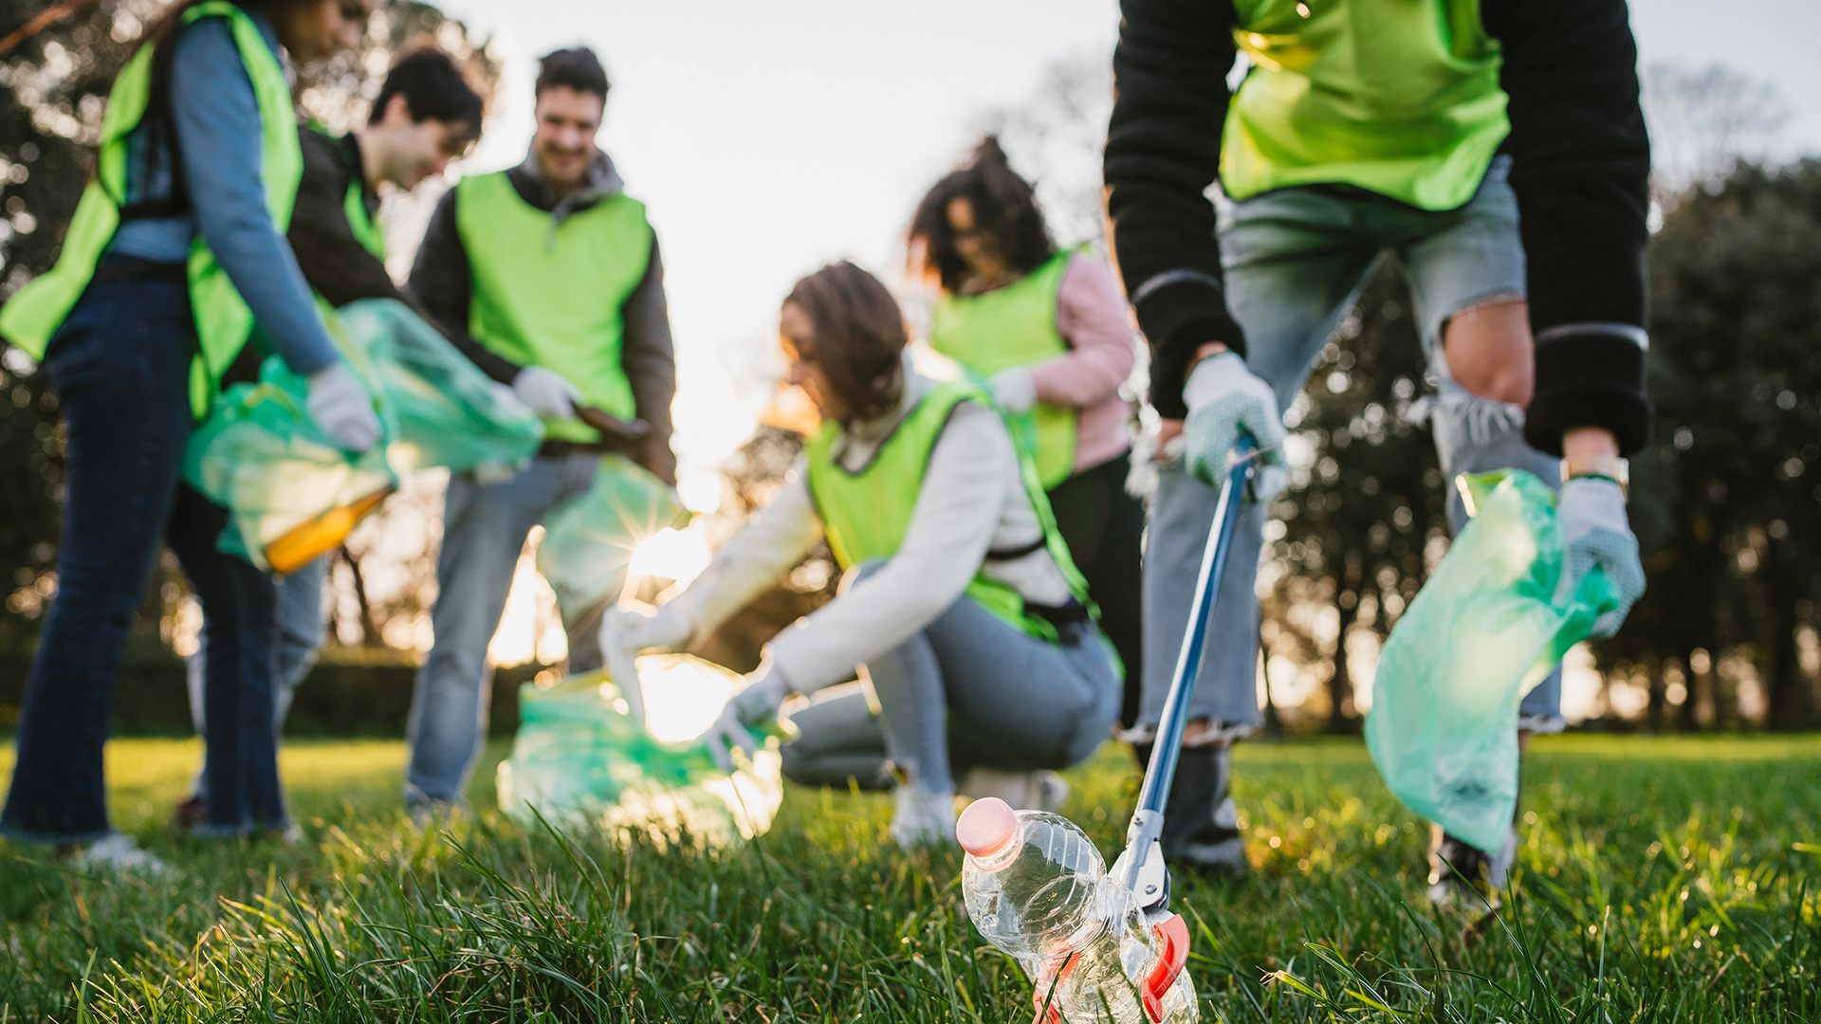
COMMUNITY INVOLVEMENT

Slide 19

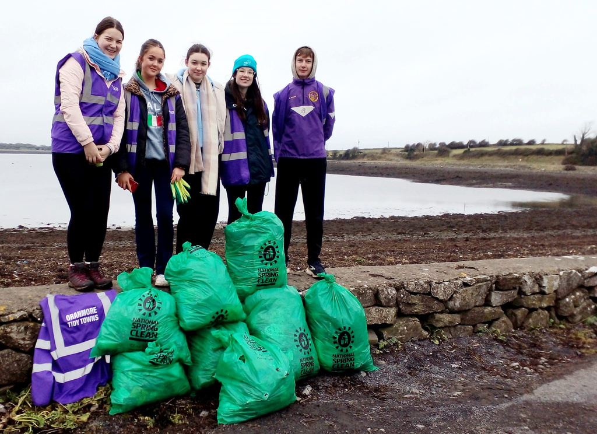
COMMUNITY INVOLVEMENT
Connect with your community and give back!
Be an active / global citizen
Individually or part of a team / group

Slide 20



COMMUNITY INVOLVEMENT
SCHOOL based
Community
OTHER GOOD STUFF
Buddy / Mentoring System
Green Schools
Amber Flag
Fundraising Committee
School Choir
School Drama Production
Peer Reading
Run a Campaign
Breakfast Clubs
Homework Clubs
School Prefect
School Council
Community Garden
YSI
Library volunteer
Prefect
Peer Coaching with a Sporting Club (GAA, soccer)
Tidy Towns
Community Garden
Charity Shop Volunteer
Animal Shelter Volunteer
Walking Elderly Neighbours Dog
Shopping for an Elderly Neighbour
Joining a campaign group, e.g. climate action group
Visiting a Nursing Home
Volunteer with a community group
Church choir
Parkrun race marshal
Order of Malta
Youth Club Volunteer
Girl Guide Volunteer
Scout Volunteer
Youth Leadership Course
Join a college society/club
Student’s Union

Slide 21
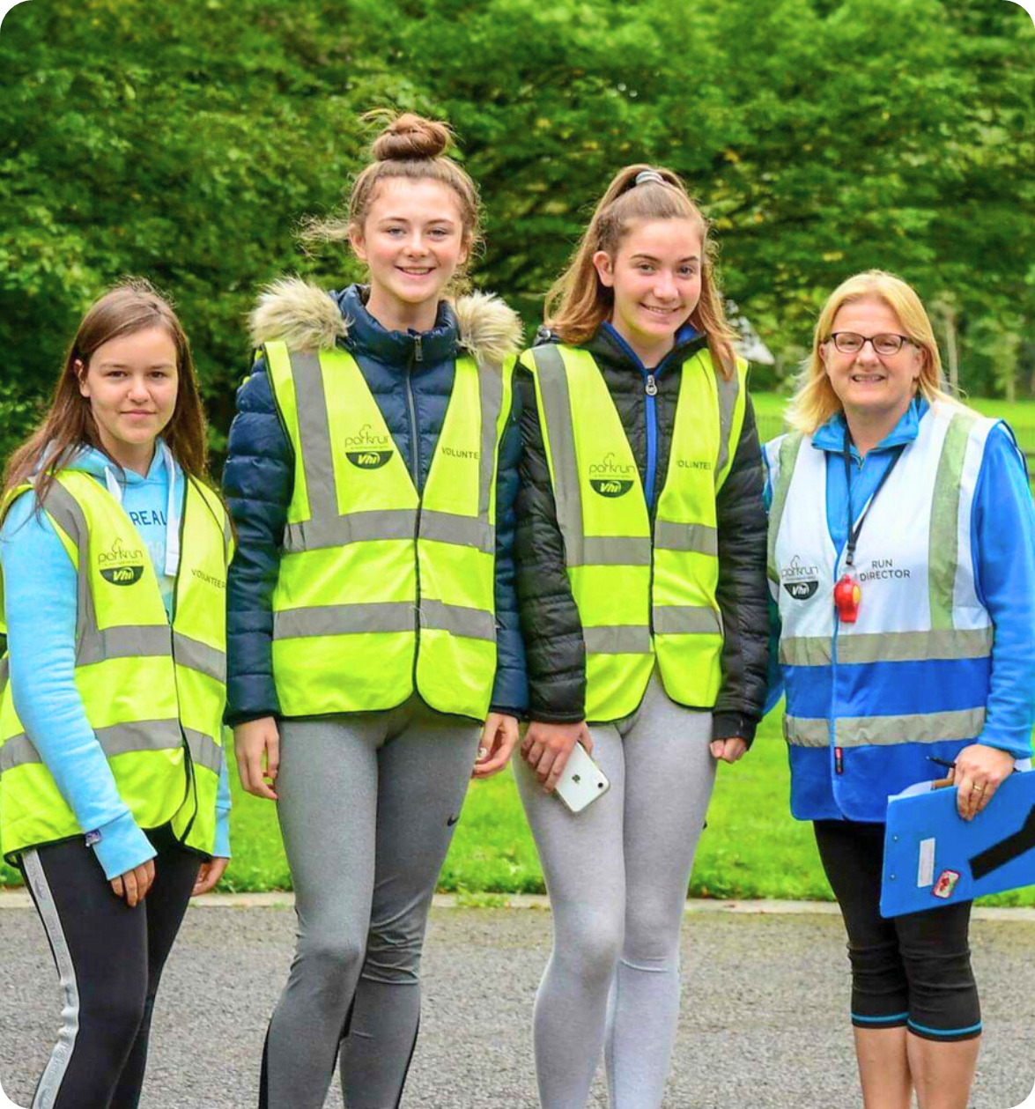
Challenge Partners

Slide 22
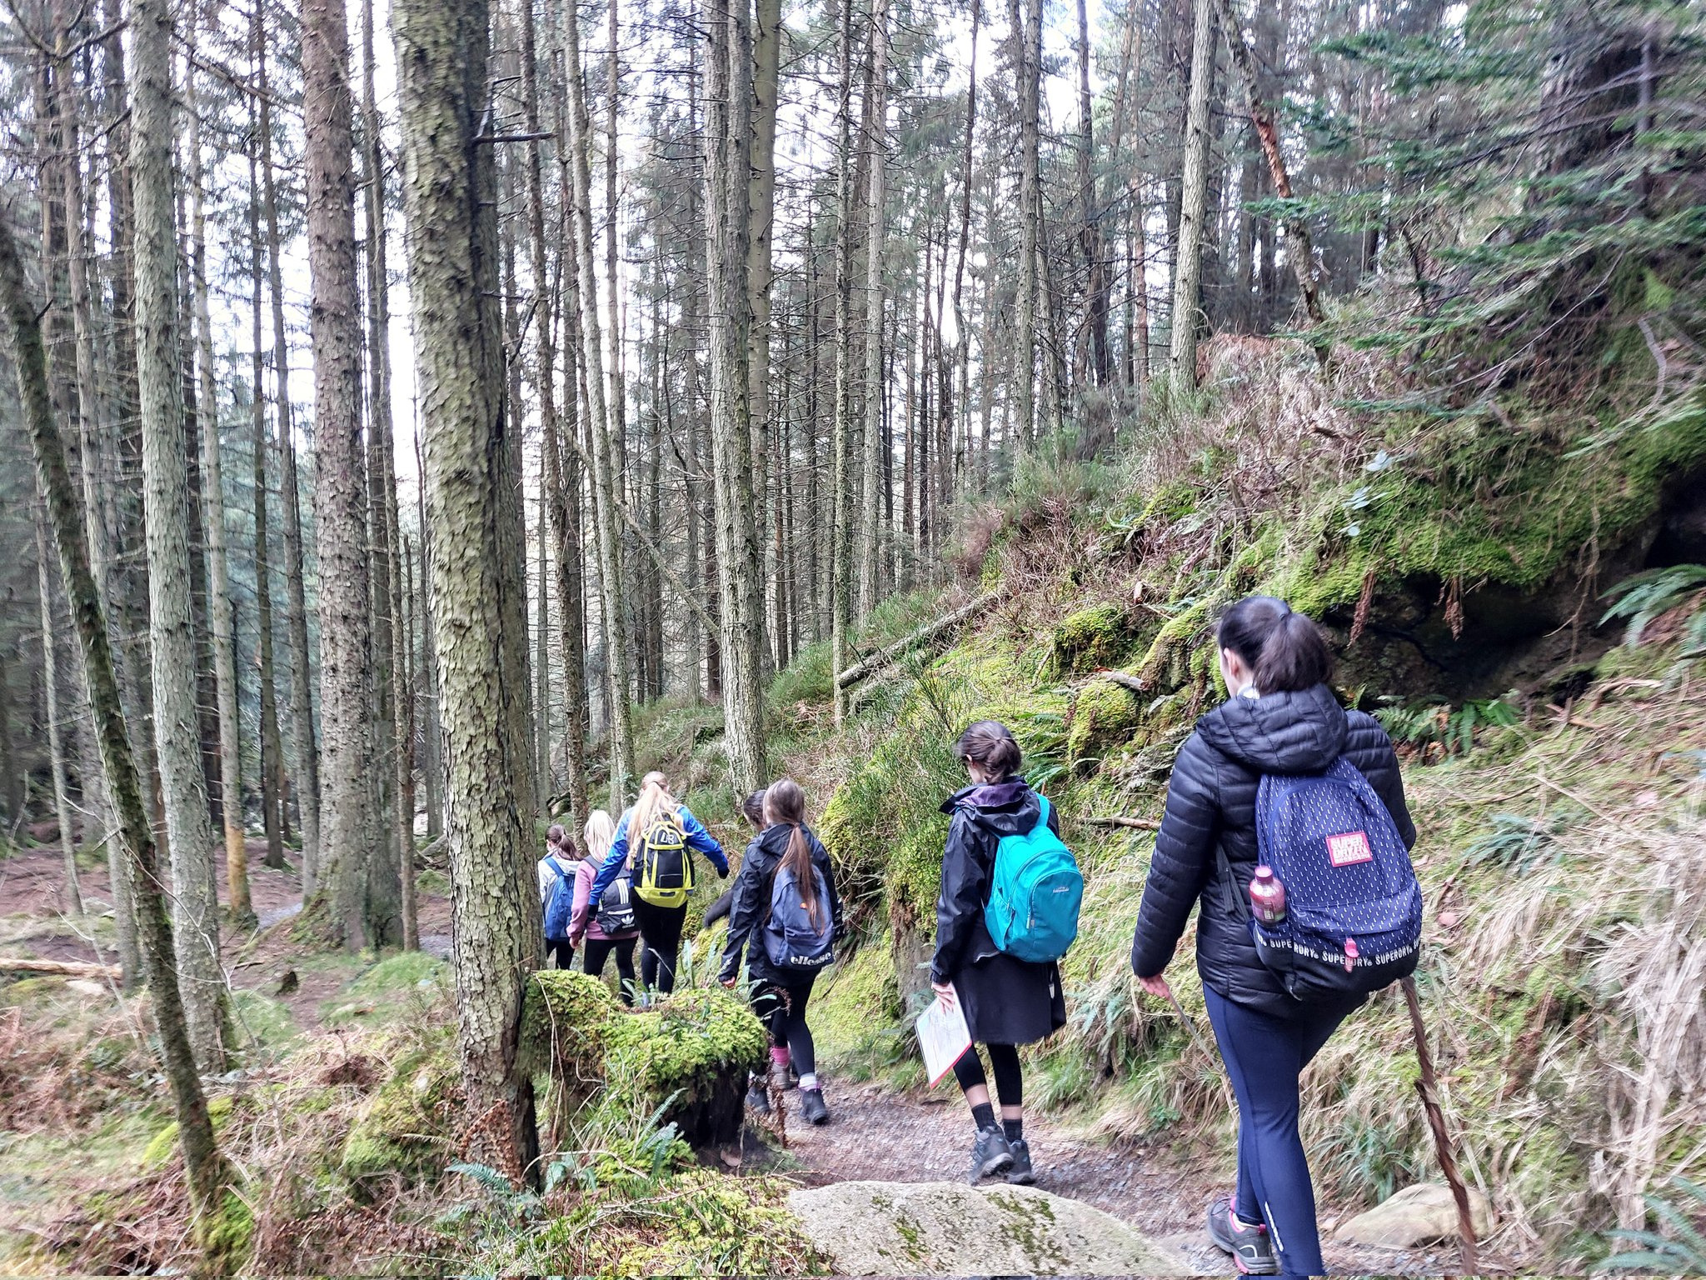
ADVENTURE JOURNEY

Slide 23
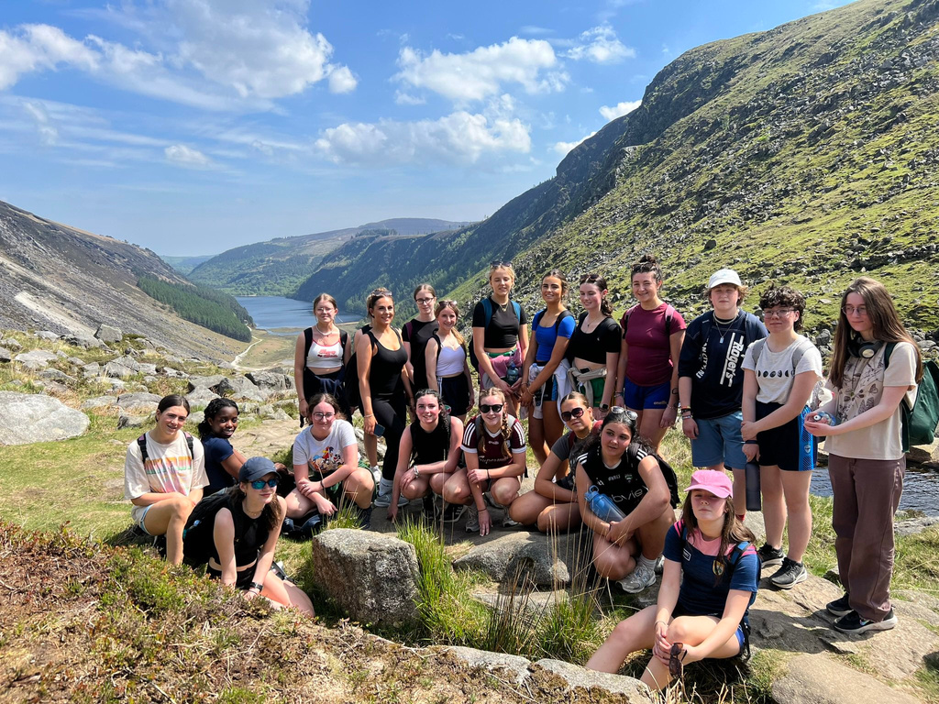
ADVENTURE JOURNEY
Discover the great outdoors and go outside of your comfort zone
Outdoor skills, teamwork and leadership
Bonding experience with your
peers and PAL/s

Slide 24
ADVENTURE JOURNEY
BRONZE
SILVER
GOLD
2 days + 1 night
3 days + 2 night
4 days + 3 night
Distance
25km walking or
100km cycling or
6 hours of meaningful activity per day
Distance
50km walking or
190km cycling or
7 hours of meaningful activity per day
Distance
80km walking or
300km cycling or
8 hours of meaningful activity per day
(suggested)
(suggested)
(suggested)
Must be completed over
2 consecutive days
Must be completed over
3 consecutive days
Must be completed over
4 consecutive days

Slide 25











CHALLENGE AREA’S
DEVELOP ONE CHALLENGE AREA
AWARD
LEVEL
Physical
Recreation
Personal
Skill
Community
Involvement
ADVENTURE JOURNEY
Pick an activity for
each challenge area
13
1
13
BRONZE
AWARD
for
2
1
hour of each per week
weeks
days
14+
€15
Continue
one challenge area
Min age
Registration
weeks
night
1
26
26
SILVER AWARD
for
3
2
hour of each per week
weeks
If no
Bronze
Award
days
15+
€20
RESIDENTIAL
PROJECT
Min age
Registration
weeks
Continue
one challenge area
nights
PORTFOLIO
1
26
52
GOLD AWARD
for
4
3
5
4
hour of each per week
weeks
days
days
If no
Silver
Award
17+
€25
Continue
one challenge area
Min age
Registration
weeks
nights
nights

Slide 26


EXAMPLE
BRONZE GAISCE AWARD
PERSONAL
SKILL
PHYSICAL RECREATION
COMMUNITY INVOLVEMENT
ADVENTURE JOURNEY / EXPEDITION
Learning guitar
Soccer
Student Council
1 hour per week
for 13 weeks
1 hour per week
for 13 weeks
1 hour per week
for 13 weeks
Waterford Greenway
2 days & 1 night
Learning guitar
Additional 13 weeks

Slide 27

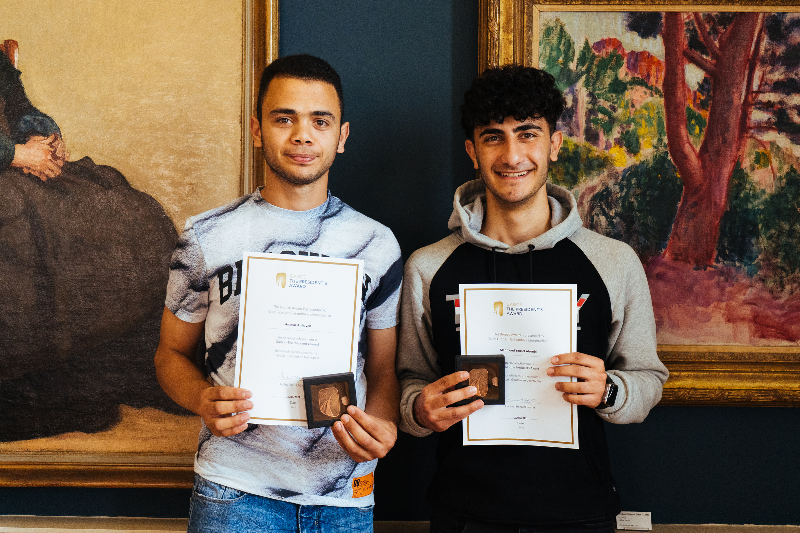
WHY DO IT ?
Self belief, confidence and resilience
An independent and self-motivating attitude
A positive connection and contribution to
local community
New & improved interests & abilities
Nationally & internationally recognised award
Looks good on a CV

Slide 28

THINK ABOUT
What do you want to do in each challenge area?
Will it last the required number of weeks?
Who will vouch for you / sign off?
Which challenge area with you choose
for your additional time?

Slide 29
GET REGISTERED
1
Find a PAL in your school / organisation who will support you throughout the course of the award.
2
Select your activities for each section of the award.
3
Agree your activities with your PAL.
4
Agree with your PAL how you will pay to register - either yourself or via your PAL.

Slide 30

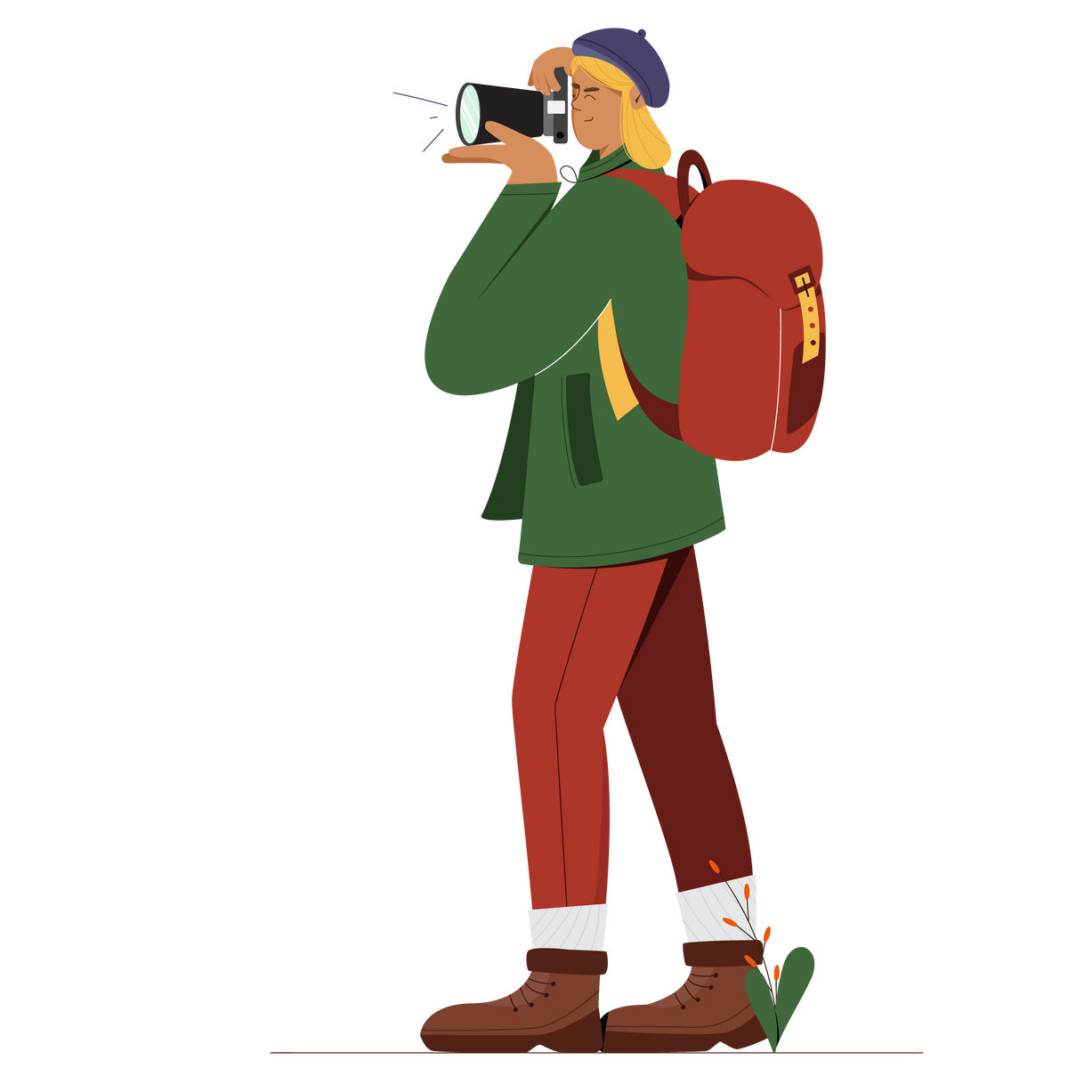



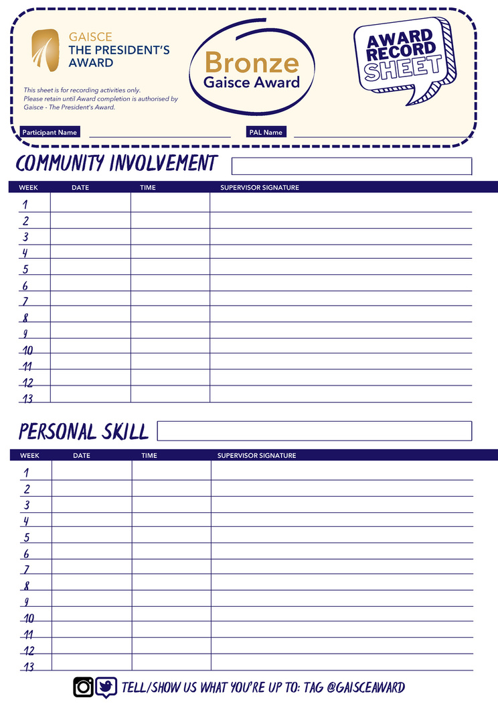


TRACKING PROGRESS
JOURNAL
YOUR
PORTFOLIO

Slide 31
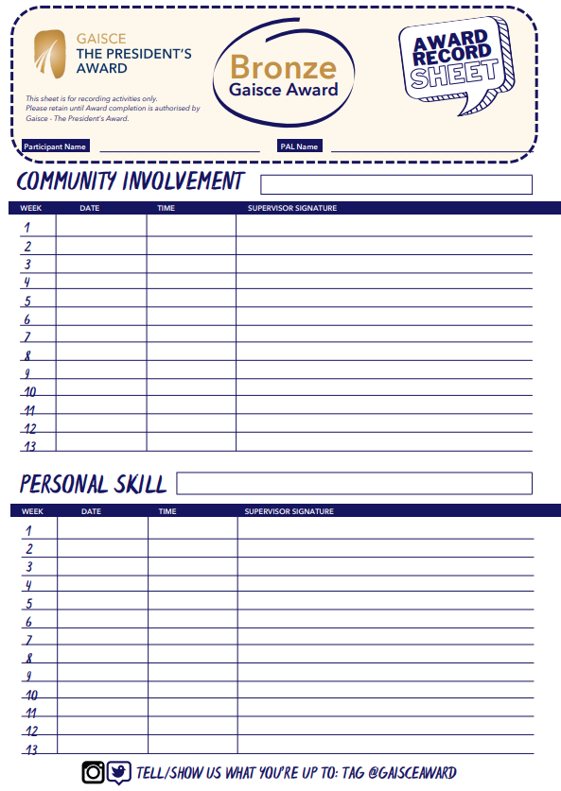
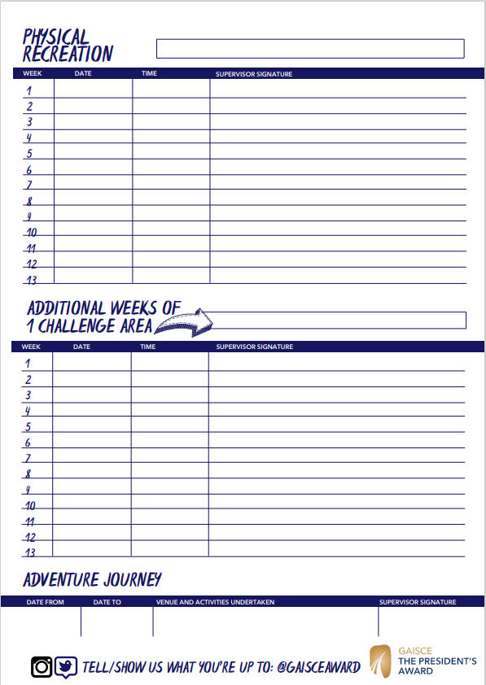

Slide 32
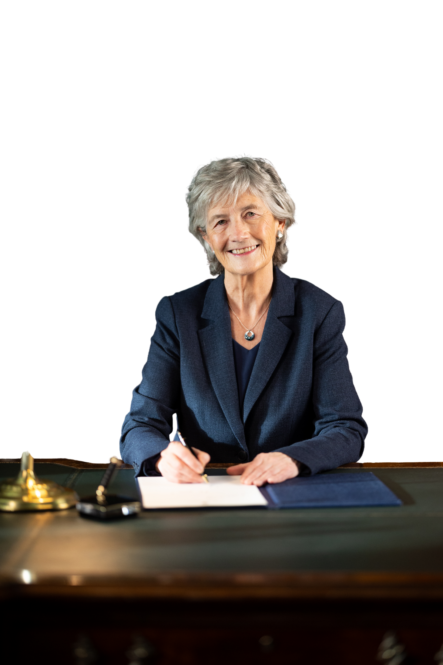
/
LA GAISCE
21st October
#LáGaisce

Slide 33

CONFIDENCE
DEVELOPEMNT
You are not comparing yourself to anyone;
FUN
SKILLS
You are not competing with anyone;
What you are actually doing is
CREATING YOURSLEF

Slide 34

?
Question &
Answers

Slide 35
Thank You

