Slide 1
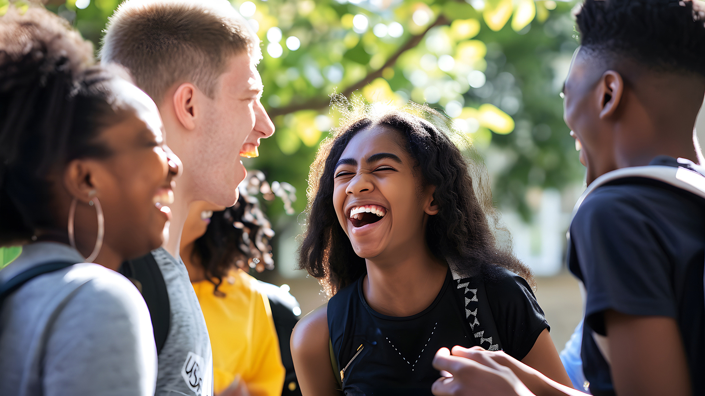




YOUR WAY, YOUR AWARD!
@GaisceAward

Slide 2


Slide 3
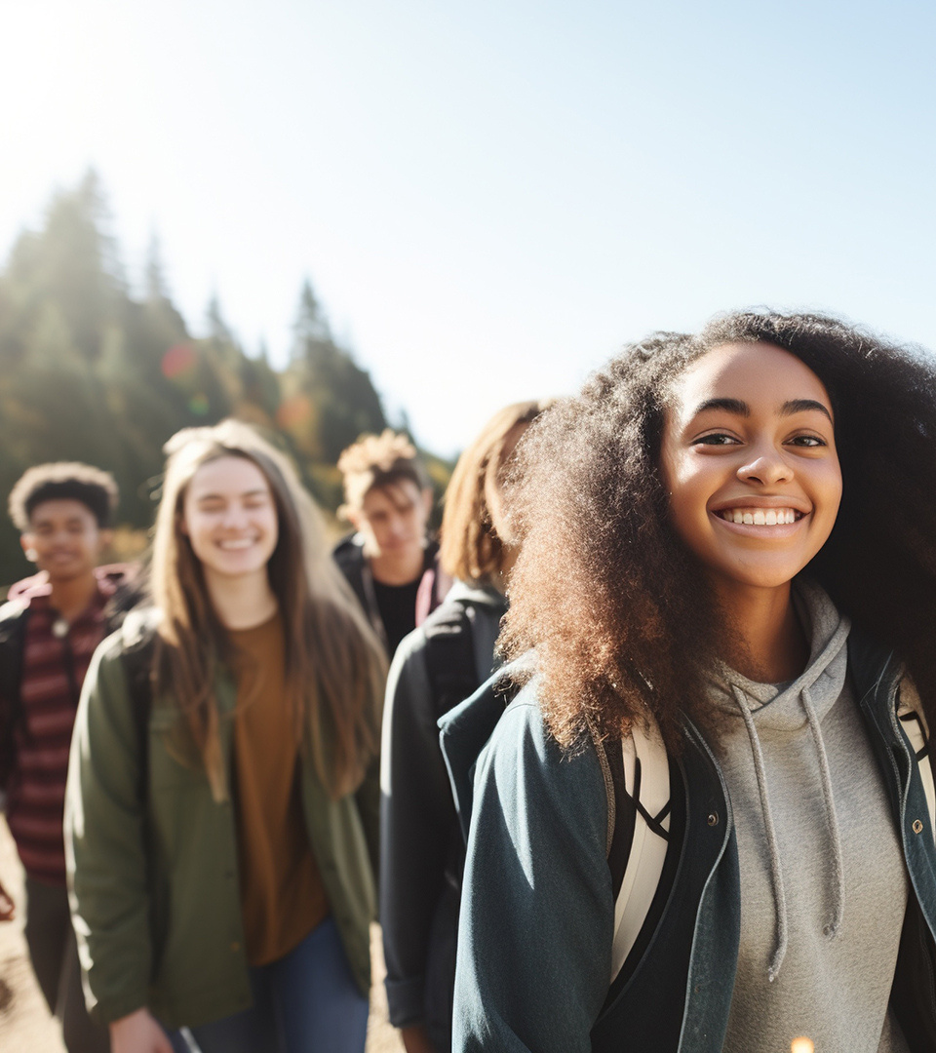

WHAT IS THE GAISCE AWARD?
A self-development programme for young people between the ages of 14 - 25 in Ireland.
Non–Formal
Non–Competitive
Self–Directed

Slide 4
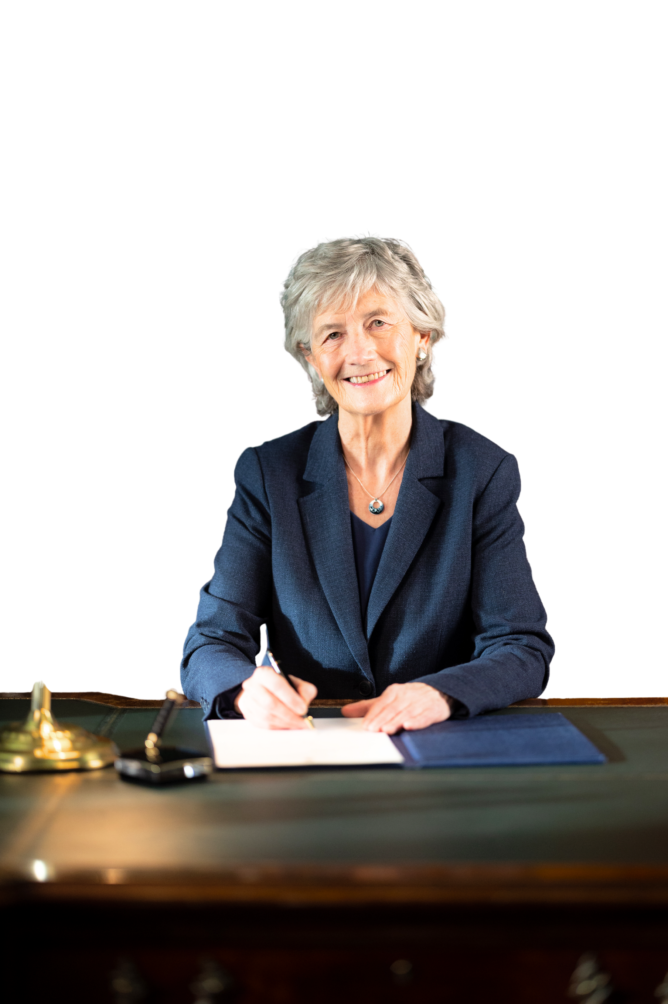


It is a direct challenge from
the President of Ireland,
Catherine Connelly for you to...
DREAM BIG
AND REALISE
YOUR POTENTIAL

Slide 5
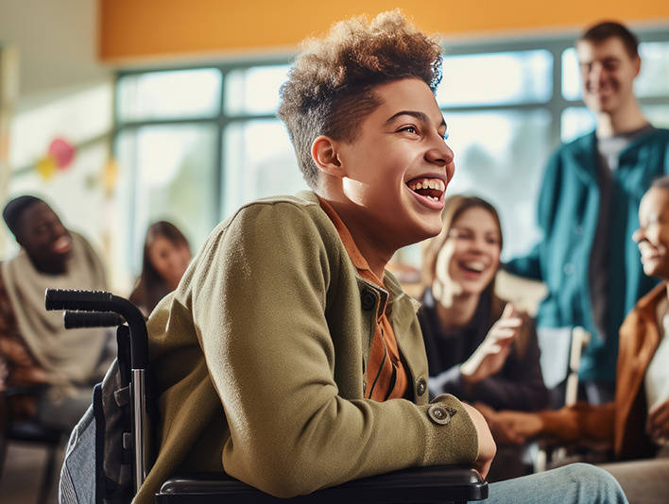

WHO CAN DO GAISCE?
&
MUST BE
Based in
14 - 25
Ireland
years of age
Students
Youth Services & Youth Clubs
Colleges & Third Level Education
Scouts & Guides
Sports Clubs
Youth Reach
Community Training Centres
Disability Groups, Special
Schools & more

Slide 6

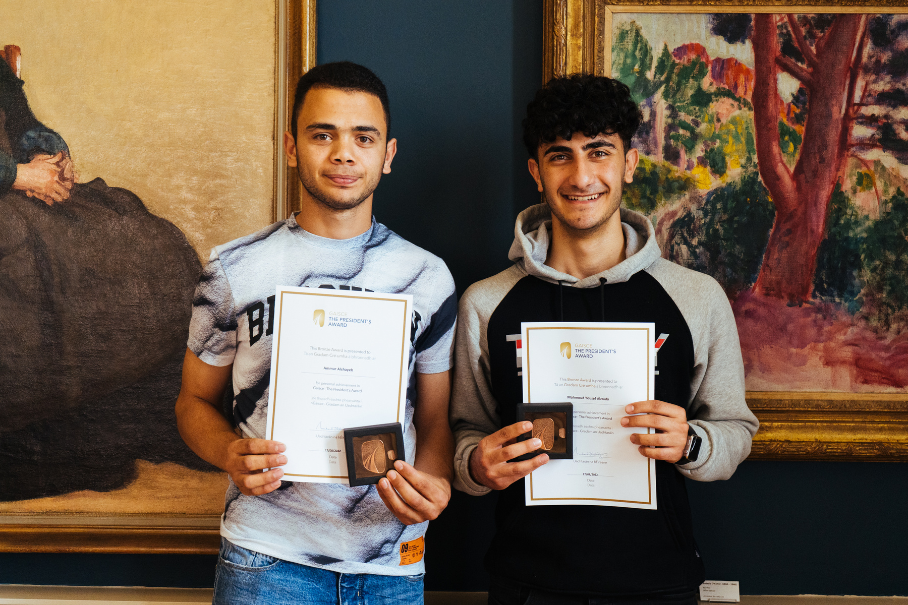
GUIDING PRINCIPLES
Persistence
Balanced
Achievable
Fun
Voluntary
Individual
Progressive
Non-Competitive
Development

Slide 7
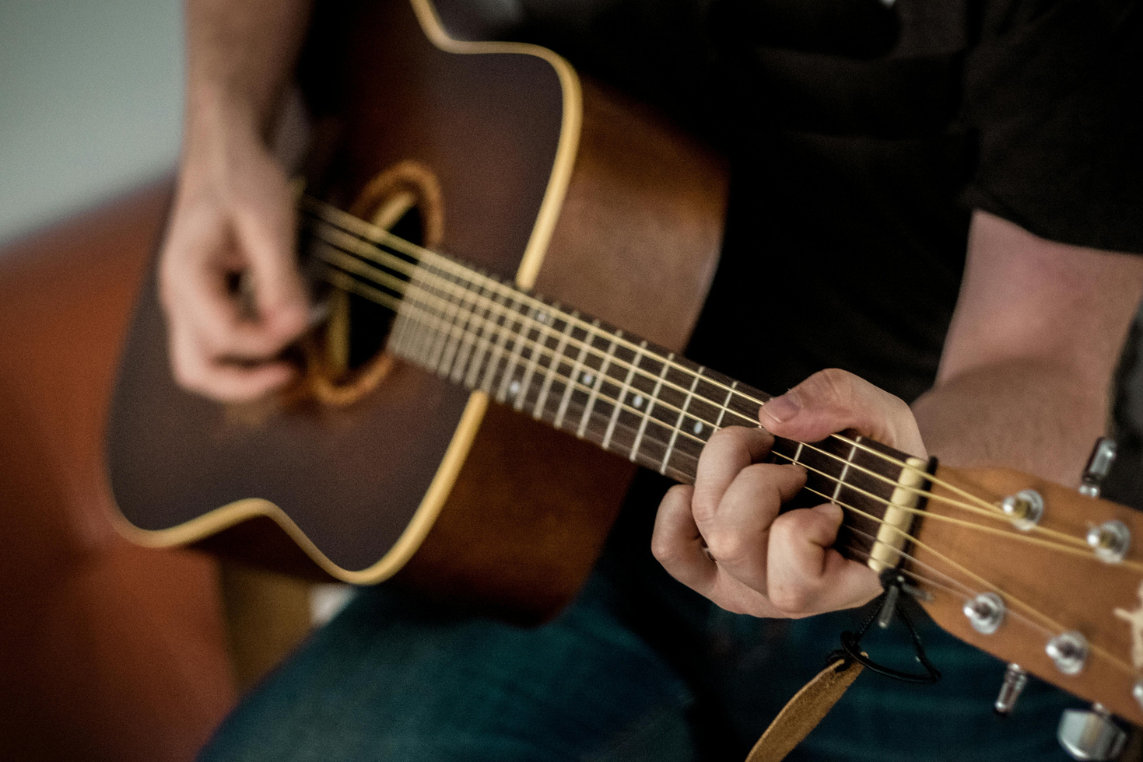
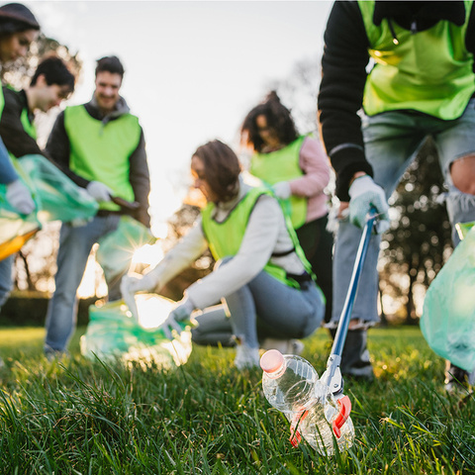
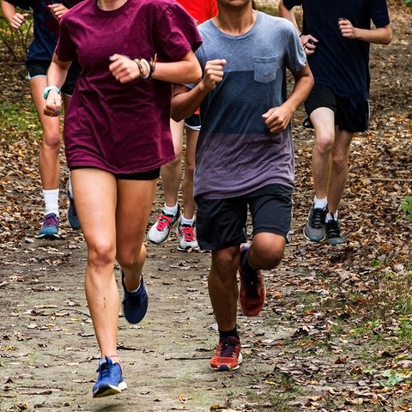
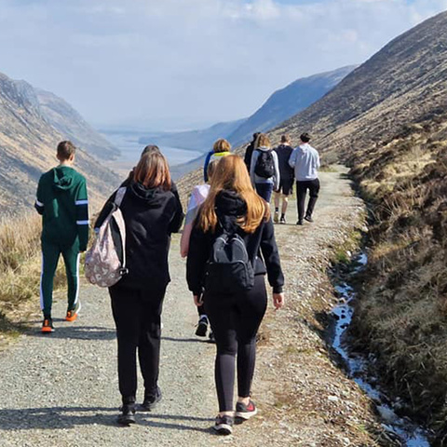
GAISCE
CHALLENGE AREAS !
PERSONAL SKILL
COMMUNITY INVOLVEMENT
PHYSICAL RECREATION
ADVENTURE JOURNEY

Slide 8
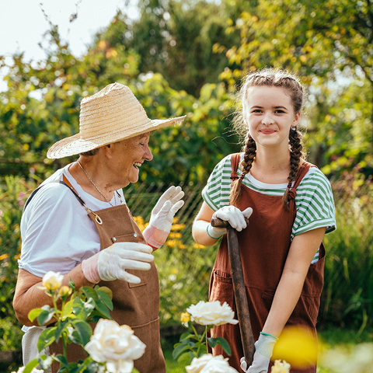
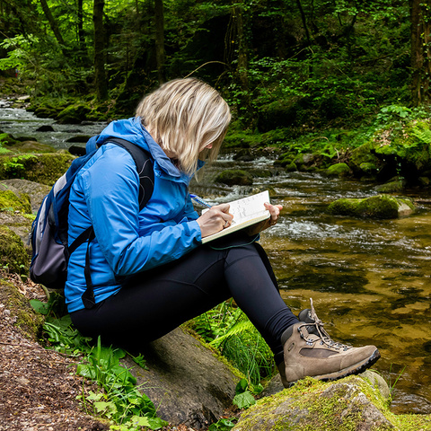
Gold
Award
Only
GAISCE
CHALLENGE AREAS !
RESIDENTIAL PROJECT
GOLD PORTFOLIO

Slide 9



AWARDS LEVELS
BRONZE
SILVER
GOLD

Slide 10











26
To achieve your
BRONZE
AWARD
Total
Plus
weeks
COMMUNITY
INVOLVEMENT
13
ADVENTURE JOURNEY
PERSONAL SKILL
with your Gaisce Group
weeks
PHYSICAL
RECREATION
13
1
Continue with your favourite activity from the first 13 weeks!
hour of each activity a week
weeks
2 days + 1 night

Slide 11
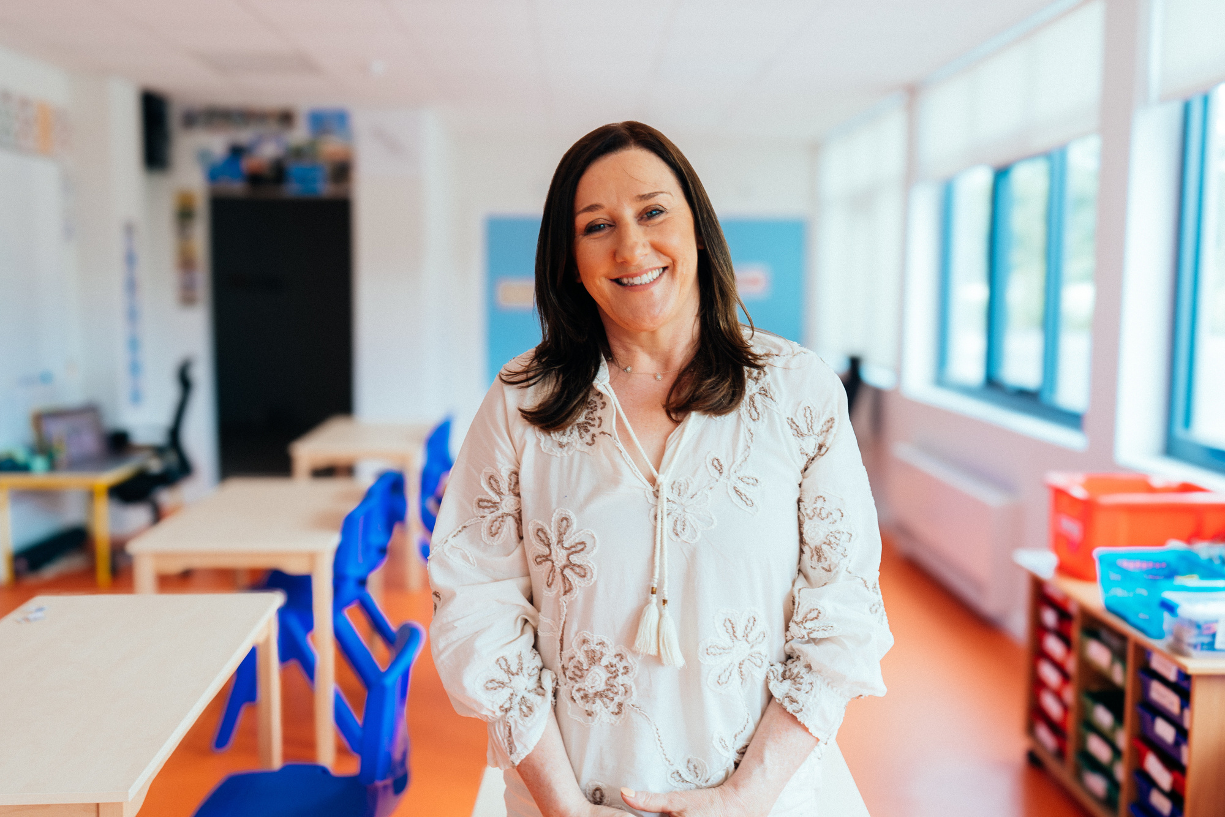
YOUR PAL
You will have a President’s Award Leader to guide you on your journey

Slide 12
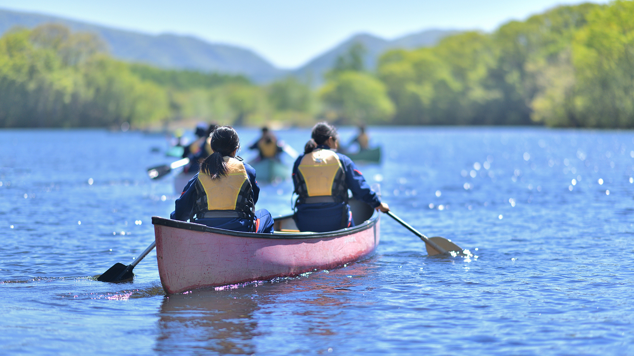
PHYSICAL RECREATION

Slide 13

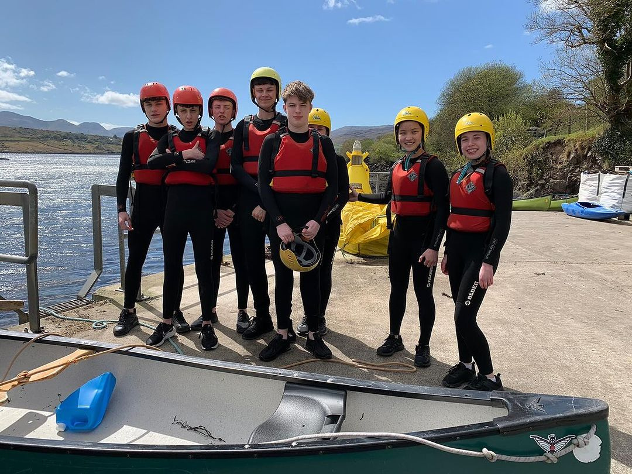
PHYSICAL RECREATION
For your physical health and wellbeing
Being active!
A new physical activity or something you already enjoy
Individually or part of a team / group

Slide 14



PHYSICAL RECREATION
Sports
Individual
OTHER GOOD STUFF
Exercise class
Parkrun
Yoga / Pilates
Map my Walk / Map my Run
Home gym
Online Workouts
Cycling
Waking
Gymnastics
Golf
Skating
Basketball
Swimming
GAA
Wheelchair
sport
Soccer
Hockey
Boccia
Rugby
Rowing / Kayaking
Local Sports Partnership
Tennis
Boxing
Special Olympics
Physiotherapy
Going to the Gym
Couch to 5km
Martial Arts
Sailing
Hiking
Dancing
Lifesaving
Archery
BMX
Self-defence
Ultimate Frisby
Table tennis
Horse riding
Roller blading

Slide 15
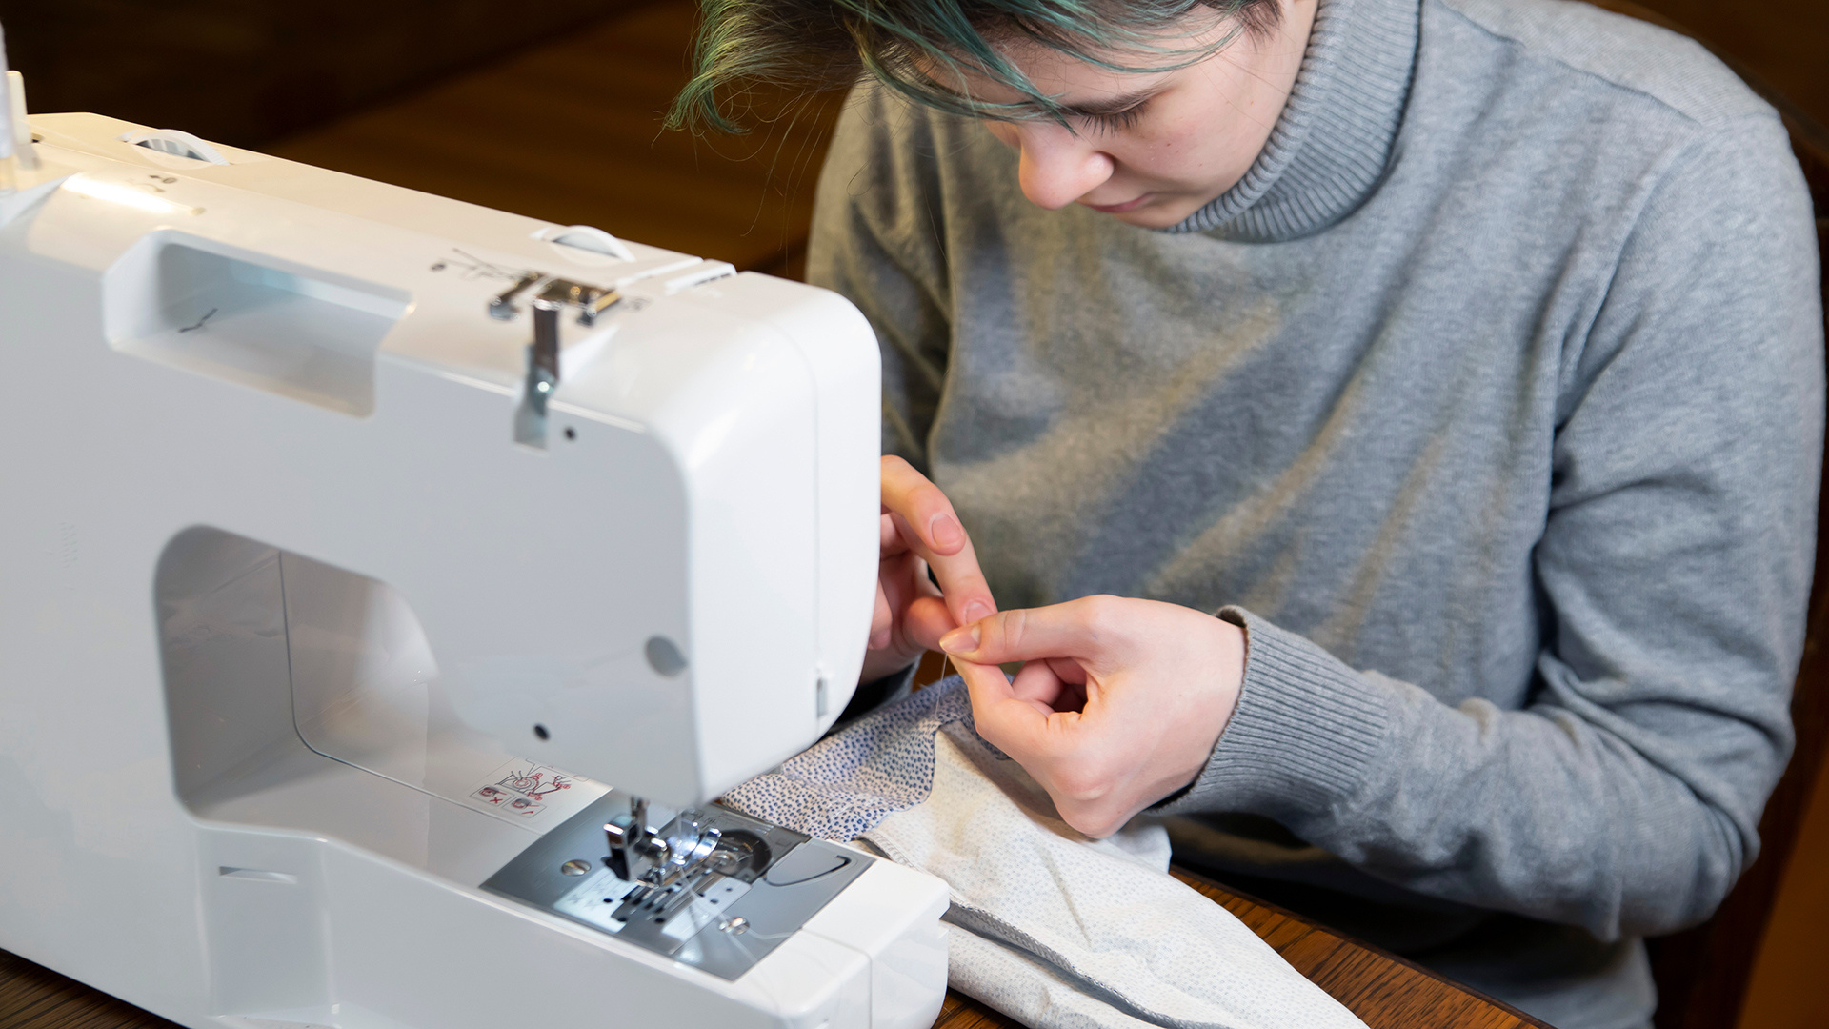
PERSONAL SKILL

Slide 16

PERSONAL SKILL
Explore your talents, interests and abilities
Develop an existing skill or try something new that interests you
Individually or part of a team / group

Slide 17



PERSONAL SKILL
with a group
general
OTHER GOOD STUFF
Baking / Cooking
class
Personal development course
Skills For Life course
Employability skills
Drama / theatre
classes
Global citizenship education
Leadership
programme
STEAM
Baking / Cooking
Arts / Crafts
Knitting
Sewing
Learning an Instrument
Learning a Language (Duo Lingo)
Mindfulness
Yoga
Online Courses
Performance Arts
Film & TV Making
Public Speaking
Photography
Web design
Counselling
Barista course
Drama
Dance
Swimming
First Aid
Life Saving
Dog Training
Poetry
Pool / snooker

Slide 18
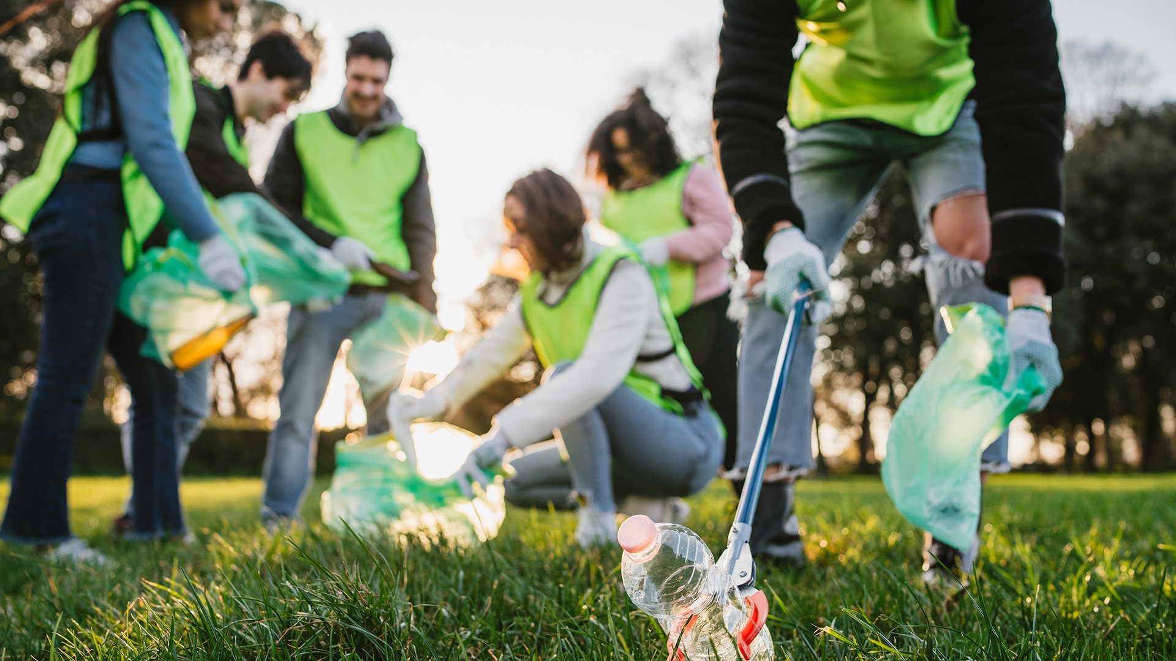
COMMUNITY INVOLVEMENT

Slide 19

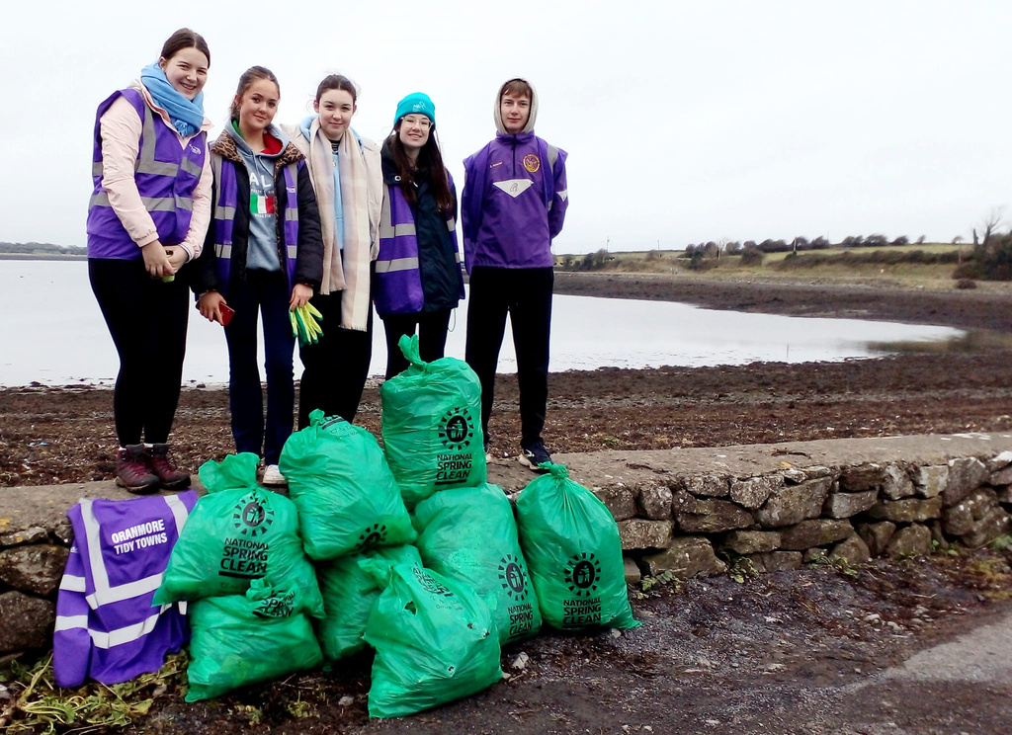
COMMUNITY INVOLVEMENT
Connect with your community and give back!
Be an active / global citizen
Individually or part of a team / group

Slide 20


COMMUNITY INVOLVEMENT
your Community
local Community
Tidy Towns
Community Garden
Volunteering
Meals On Wheels
Animal Shelter Volunteer
Canal walks / litter picking
Helping out an elderly neighbour
Joining a campaign group, e.g. climate action
Fundraising
Volunteer with a community
group
Church choir
Parkrun volunteer
Dog walking
Food cloud
Buddy / Mentoring System
Environmental committee / clean up
Choir
Drama Production
Peer support / Helper
Run a Campaign
Community Garden
Library volunteer
Fundraising
Joining up with another local project
Creating a mural / artistic feature for the organisation

Slide 21
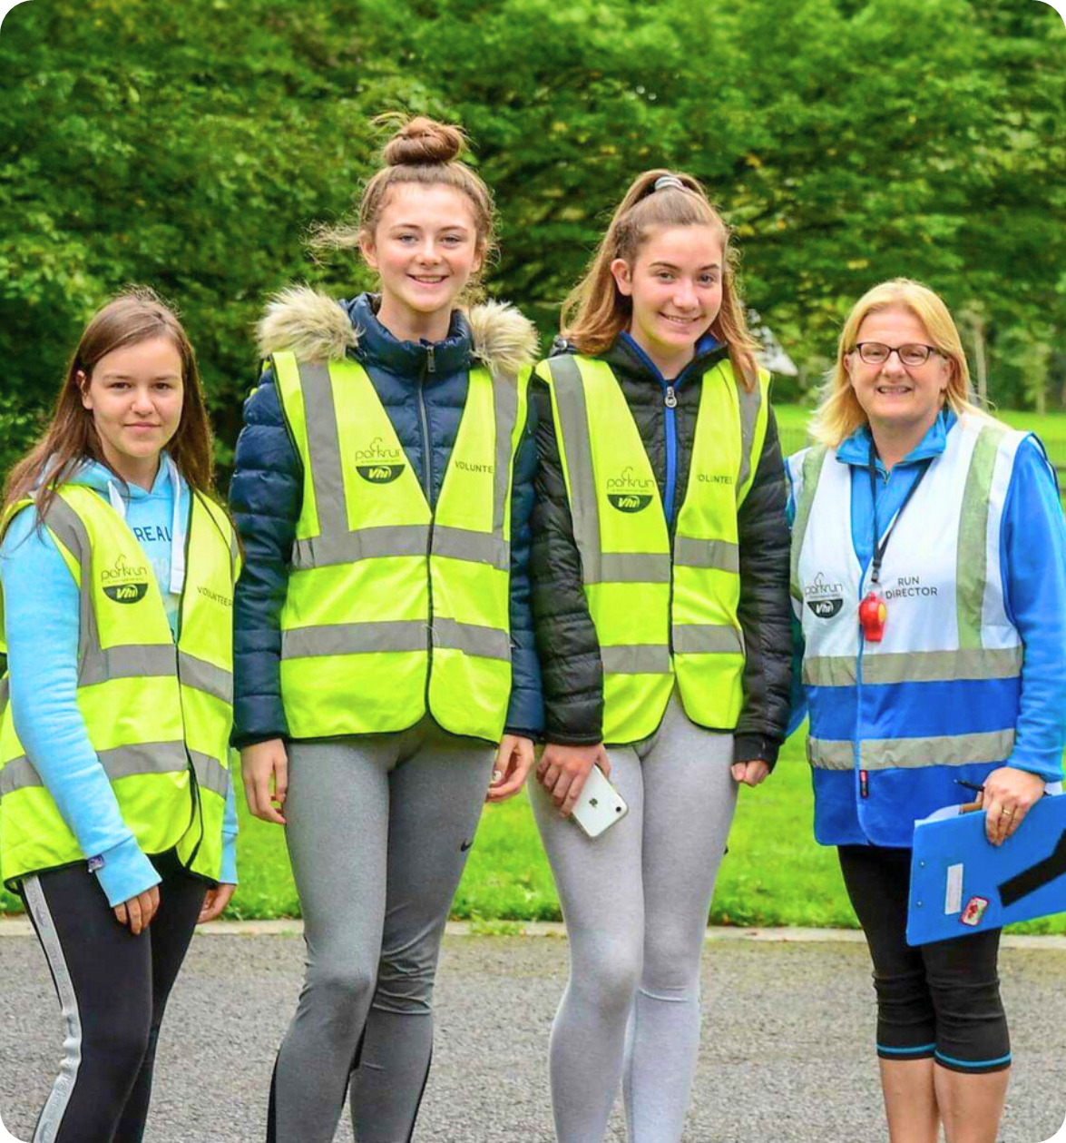
Challenge Partners

Slide 22
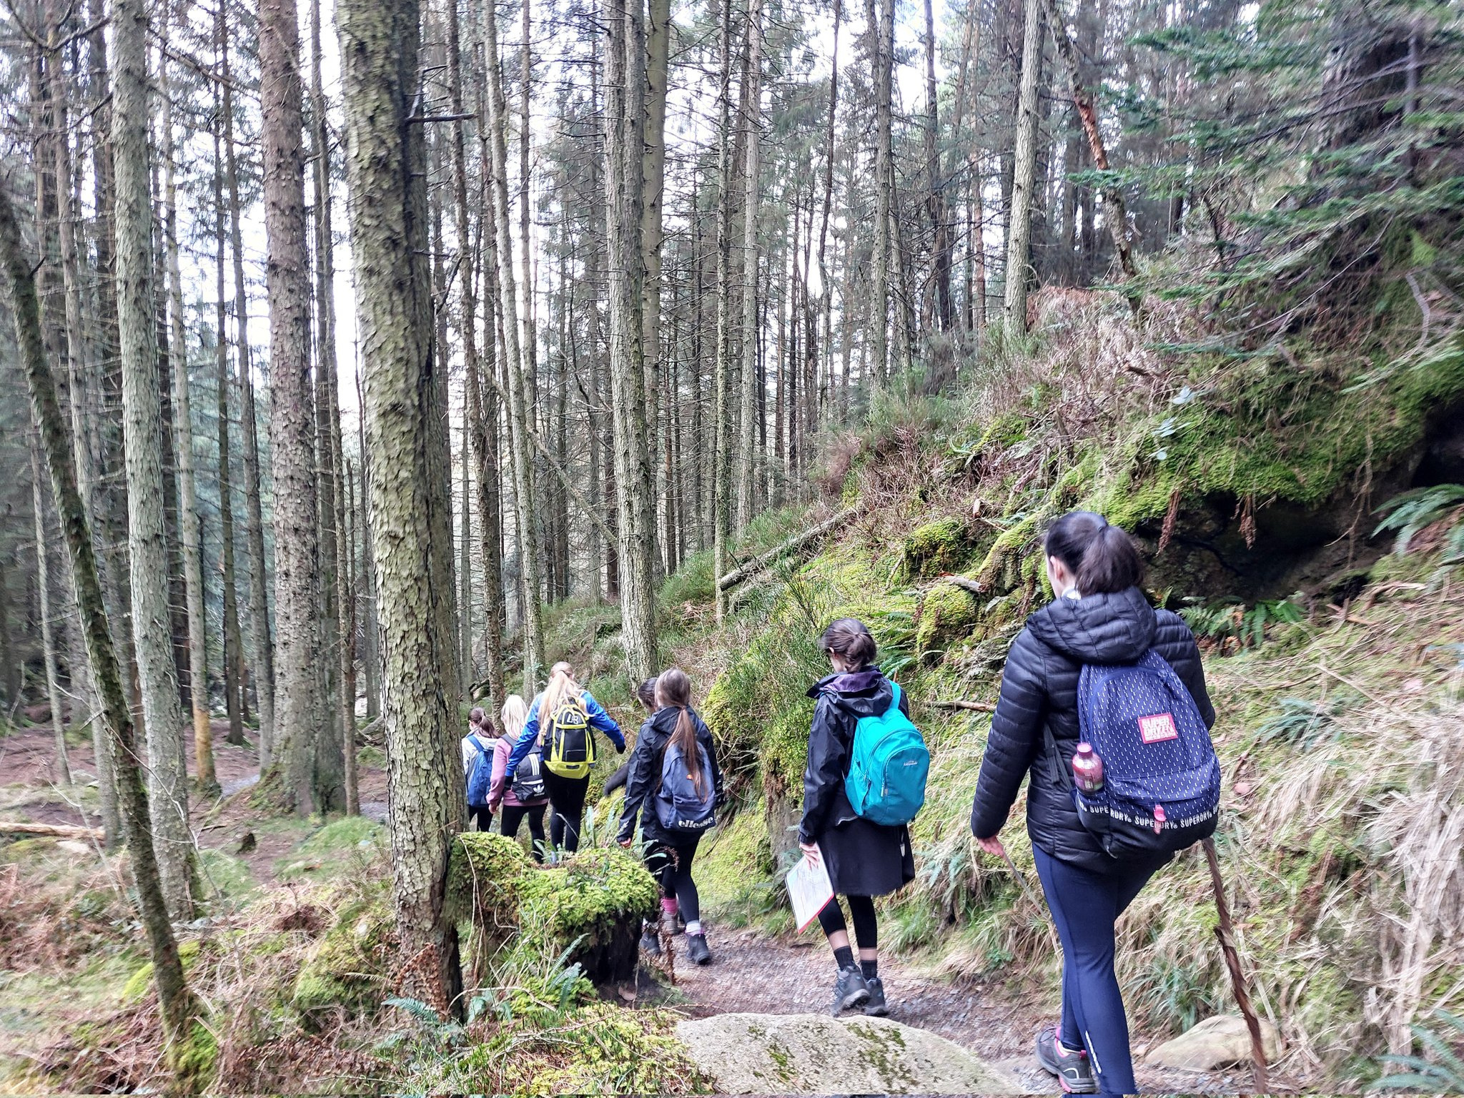
ADVENTURE JOURNEY

Slide 23
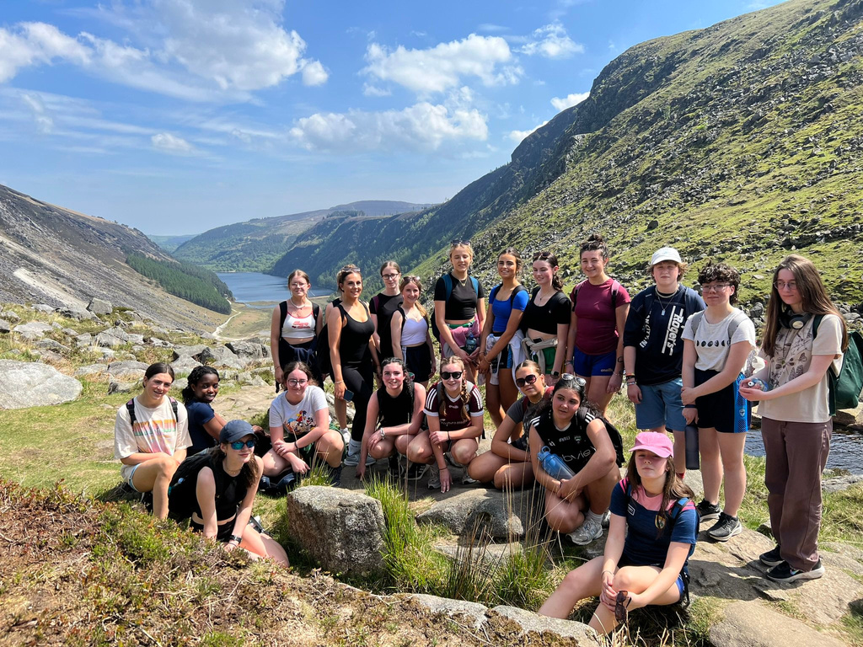
ADVENTURE JOURNEY
Discover the great outdoors and go outside of your comfort zone
Outdoor skills, team work and leadership
Bonding experience with your
peers and PAL/s

Slide 24











CHALLENGE AREA’S
DEVELOP ONE CHALLENGE AREA
AWARD
LEVEL
Physical
Recreation
Personal
Skill
Community
Involvement
ADVENTURE JOURNEY
Pick an activity for
each challenge area
13
1
13
BRONZE
AWARD
for
2
1
hour of each per week
weeks
days
14+
€15
Continue
one challenge area
Min age
Registration
weeks
night
1
26
26
SILVER AWARD
for
3
2
hour of each per week
weeks
If no
Bronze
Award
days
15+
€20
RESIDENTIAL
PROJECT
Min age
Registration
weeks
Continue
one challenge area
nights
PORTFOLIO
1
26
52
GOLD AWARD
for
4
3
5
4
hour of each per week
weeks
days
days
If no
Silver
Award
17+
€25
Continue
one challenge area
Min age
Registration
weeks
nights
nights

Slide 25


EXAMPLE
BRONZE GAISCE AWARD
PERSONAL
SKILL
PHYSICAL RECREATION
COMMUNITY INVOLVEMENT
ADVENTURE JOURNEY EXPEDITION or exploration
Life skills
Swimming
Meals on wheels volunteer
Waterford Greenway
1 hour per week
for 13 weeks
1 hour per week
for 13 weeks
1 hour per week
for 13 weeks
2 days & 1 night
Swimming
Additional 13 weeks

Slide 26

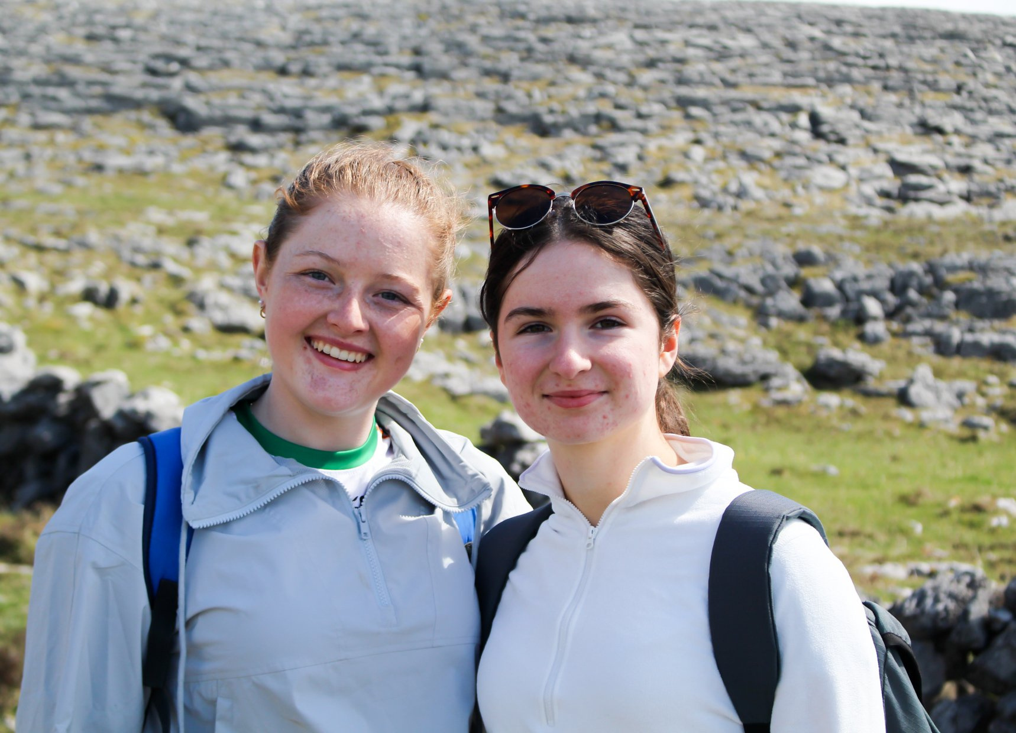
WHY DO IT ?
Self belief, confidence and resilience
An independent and self-motivating attitude
A positive connection and contribution to
local community
New & improved interests & abilities
Nationally & internationally recognised award
Looks good on a CV

Slide 27

get started
Connect with your PAL who will support you
Decide and agree your activities with your PAL for each section of the award.
Set yourself a goal and go for it!

Slide 28

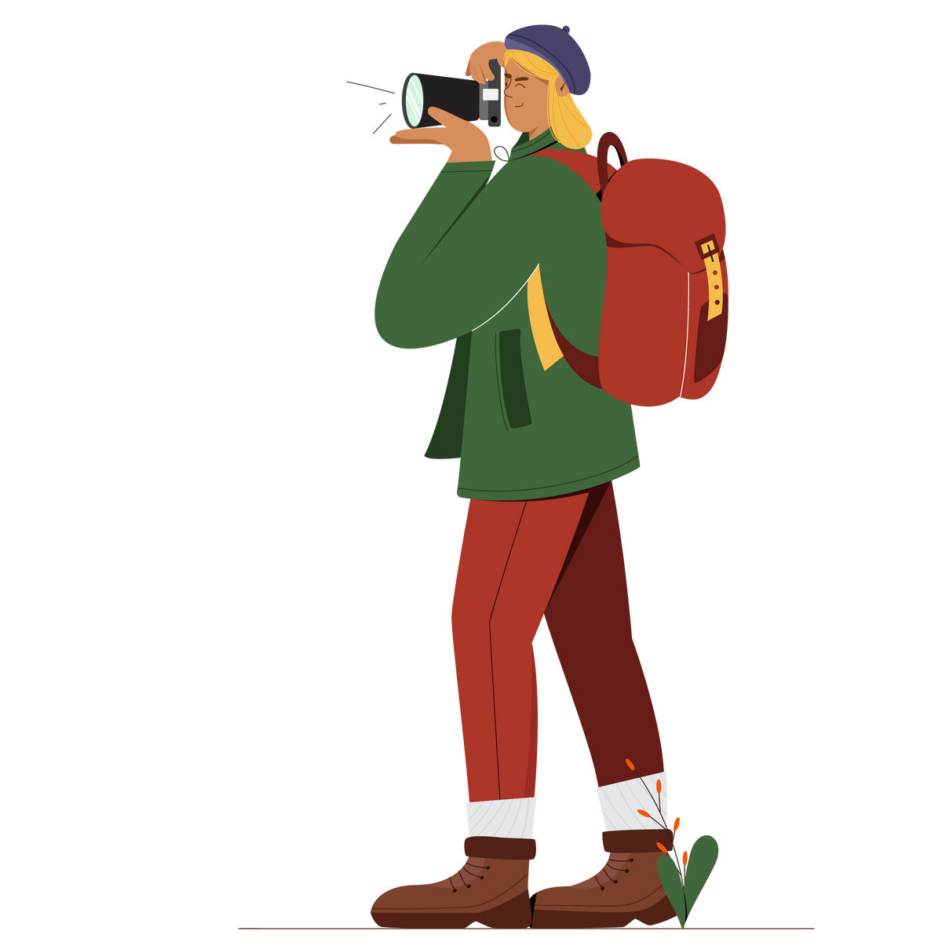



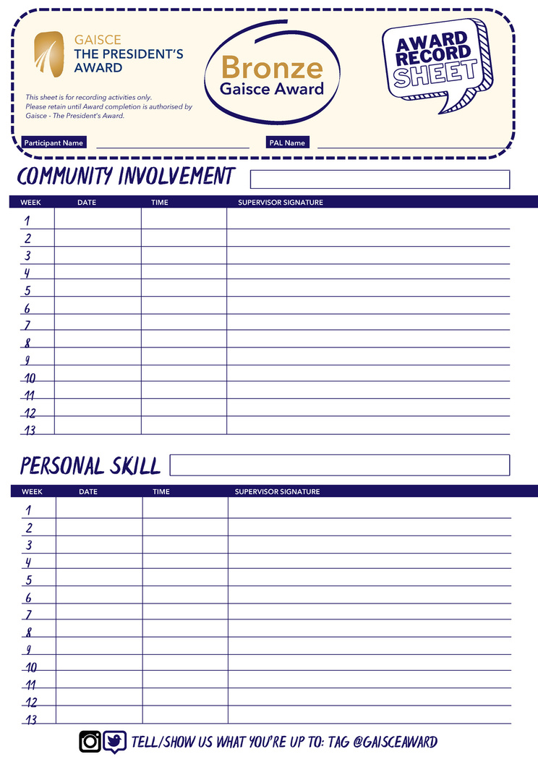


TRACKING PROGRESS
JOURNAL
YOUR
PORTFOLIO

Slide 29
/
LA GAISCE
21st October
#LáGaisce

Slide 30

CONFIDENCE
DEVELOPEMNT
You are not comparing yourself to anyone;
FUN
SKILLS
You are not competing with anyone;
What you are actually doing is
CREATING YOURSLEF

Slide 31

?
Question &
Answers

Slide 32
Thank You

